Slide 1

18CSC305J– Artificial Intelligence
UNIT – 2

Slide 2
Unit 2 List of Topics
Searching techniques – Uninformed search – General search Algorithm
Uninformed search Methods – Breadth First Search
Uninformed search Methods – Depth First Search
Uninformed search Methods – Depth limited Search
Uniformed search Methods- Iterative Deepening search
Bi-directional search
Informed search- Generate and test, Best First search
Informed search-A* Algorithm
AO* research
Local search Algorithms-Hill Climbing, Simulated Annealing
Local Beam Search
Genetic Algorithms
Adversarial search Methods-Game playing-Important concepts
Game playing and knowledge structure.
Game as a search problem-Minimax Approach
Minimax Algorithm
Alpha beta pruning
Game theory problems

Slide 3
General Search Strategies
Blind search → traversing the search space until the goal nodes is found (might be doing exhaustive search).
Techniques : Breadth First, Depth first, Depth Limited, Iterative Deepening search, Uniform Cost search.
Guarantees solution.
Heuristic search → search process takes place by traversing search space with applied rules (information).
Techniques: Greedy Best First Search, A* Algorithm
There is no guarantee that solution is found.

Slide 4
Important Terms
Search space → possible conditions and solutions.
Initial state → state where the searching process started.
Goal state → the ultimate aim of searching process.
Problem space → “what to solve”
Searching strategy →strategy for controlling the search.
Search tree → tree representation of search space, showing possible solutions from initial state.

Slide 5
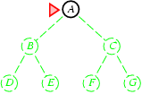
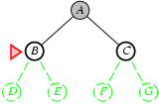
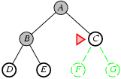
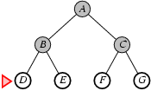
Blind Search : Breadth First Search
1
2
3
4

Slide 6
Blind strategies BFS
Blind Search : Breadth First Search
Search Methods
BFS characteristics
Completeness: if the branching factor is ‘b’ and the goal node is at depth d, BFS will eventually find it.
Optimality: BFS is optimal if path cost is a non-decreasing function of depth.ª
Time complexity:
1 + b + b² + b³ + . . . + b^{d} + b(b^{d} − 1) = O(b^{d+1}).
Space complexity: O(b^{d+1}).^{b}
ª Otherwise, the shallowest node may not necessarily be optimal.
^{b}b branching factor; d depth of the goal node
spring 2011

Slide 7
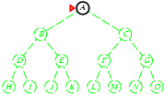
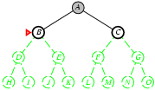
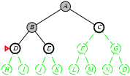
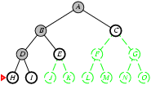
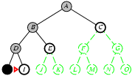
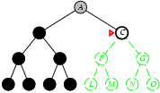
Blind Search : Depth First Search (DFS)
Implementation:
fringe = LIFO queue, i.e., put successors at front.
1
2
3
4
5
N+1
…….

Slide 8
Blind Search : Depth First Search (DFS)
Search Methods
DFS characteristics
Small space requirements: only the path to the current node and the siblings of each node in the path are stored.
Backtracking search generates only one successor for each node.
Completeness: no, if the expanded subtree has an infinite depth.
Optimality: no, if a solution located deeper, but located in a subtree expanded earlier, is found.
Time complexity: O(b ).
Space complexity: O(bm) (linear!).
m
spring 2011

Slide 9
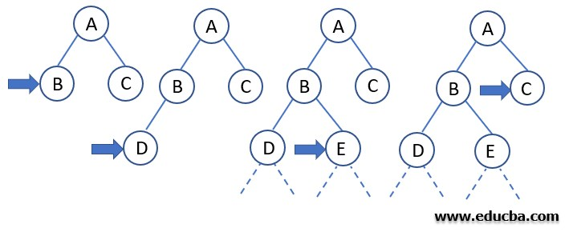
Blind Search : Depth Limited Search (DLS)
Search Methods
In Depth Limited Search, we first set a constraint on how deep (or how far from root) will we go.
In the above example , If we fix the depth limit to 2, DLS can be carried out similarly to the DFS until the goal node is found to exist in the search domain of the tree.
spring 2011

Slide 10
Unit 2 List of Topics
Searching techniques – Uninformed search – General search Algorithm
Uninformed search Methods – Breadth First Search
Uninformed search Methods – Depth First Search
Uninformed search Methods – Depth limited Search
Uniformed search Methods- Iterative Deepening search
Bi-directional search
Informed search- Generate and test, Best First search
Informed search-A* Algorithm
AO* research
Local search Algorithms-Hill Climbing, Simulated Annealing
Local Beam Search
Genetic Algorithms
Adversarial search Methods-Game playing-Important concepts
Game playing and knowledge structure.
Game as a search problem-Minimax Approach
Minimax Algorithm
Alpha beta pruning
Game theory problems

Slide 11
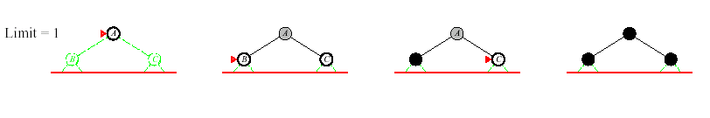
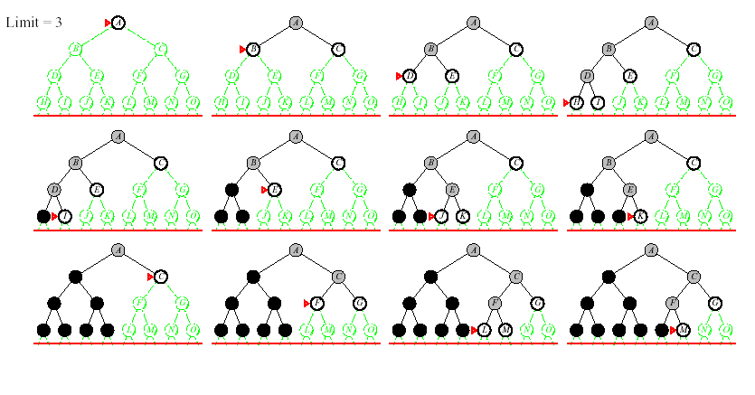
Blind Search : Iterative Deepening DFS (ID-DFS)
DEPTH LIMITED SEARCH

Slide 12
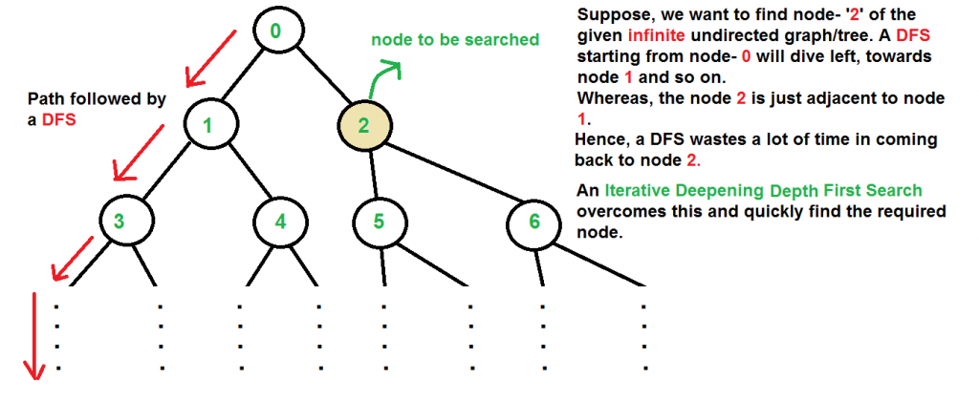
Blind Search : Iterative Deepening DFS (ID-DFS)

Slide 13
Blind Search : Iterative Deepening DFS (ID-DFS)
Search Methods
IDS characteristics
Completeness: yes.
Optimality: yes, if step cost = 1. Time complexity:
(d + 1)b⁰ + db¹ + (d − 1)b² + . . . + b^{d} = O(b^{d} ).
Space complexity: O(bd).
Numerical comparison for b = 10, d = 5
N(IDS ) = 50 + 400 + 3000 + 20000 + 100000 = 123450
N(BFS) = 10 + 100 + 1000 + 10000 + 100000 + 999990 = 1111100
Conclusion
IDS exhibits better performance, because it does not expand other nodes at depth d.

Slide 14
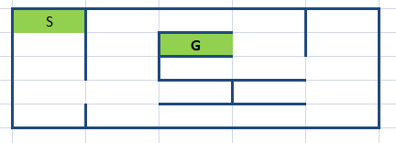
APPLICATION: MAZE GAME
HOW TO REACH TO THE GOAL?

Slide 15
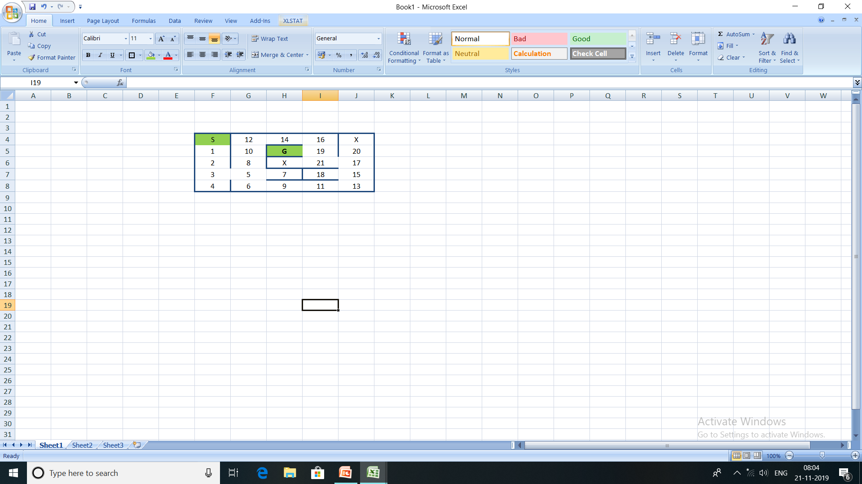
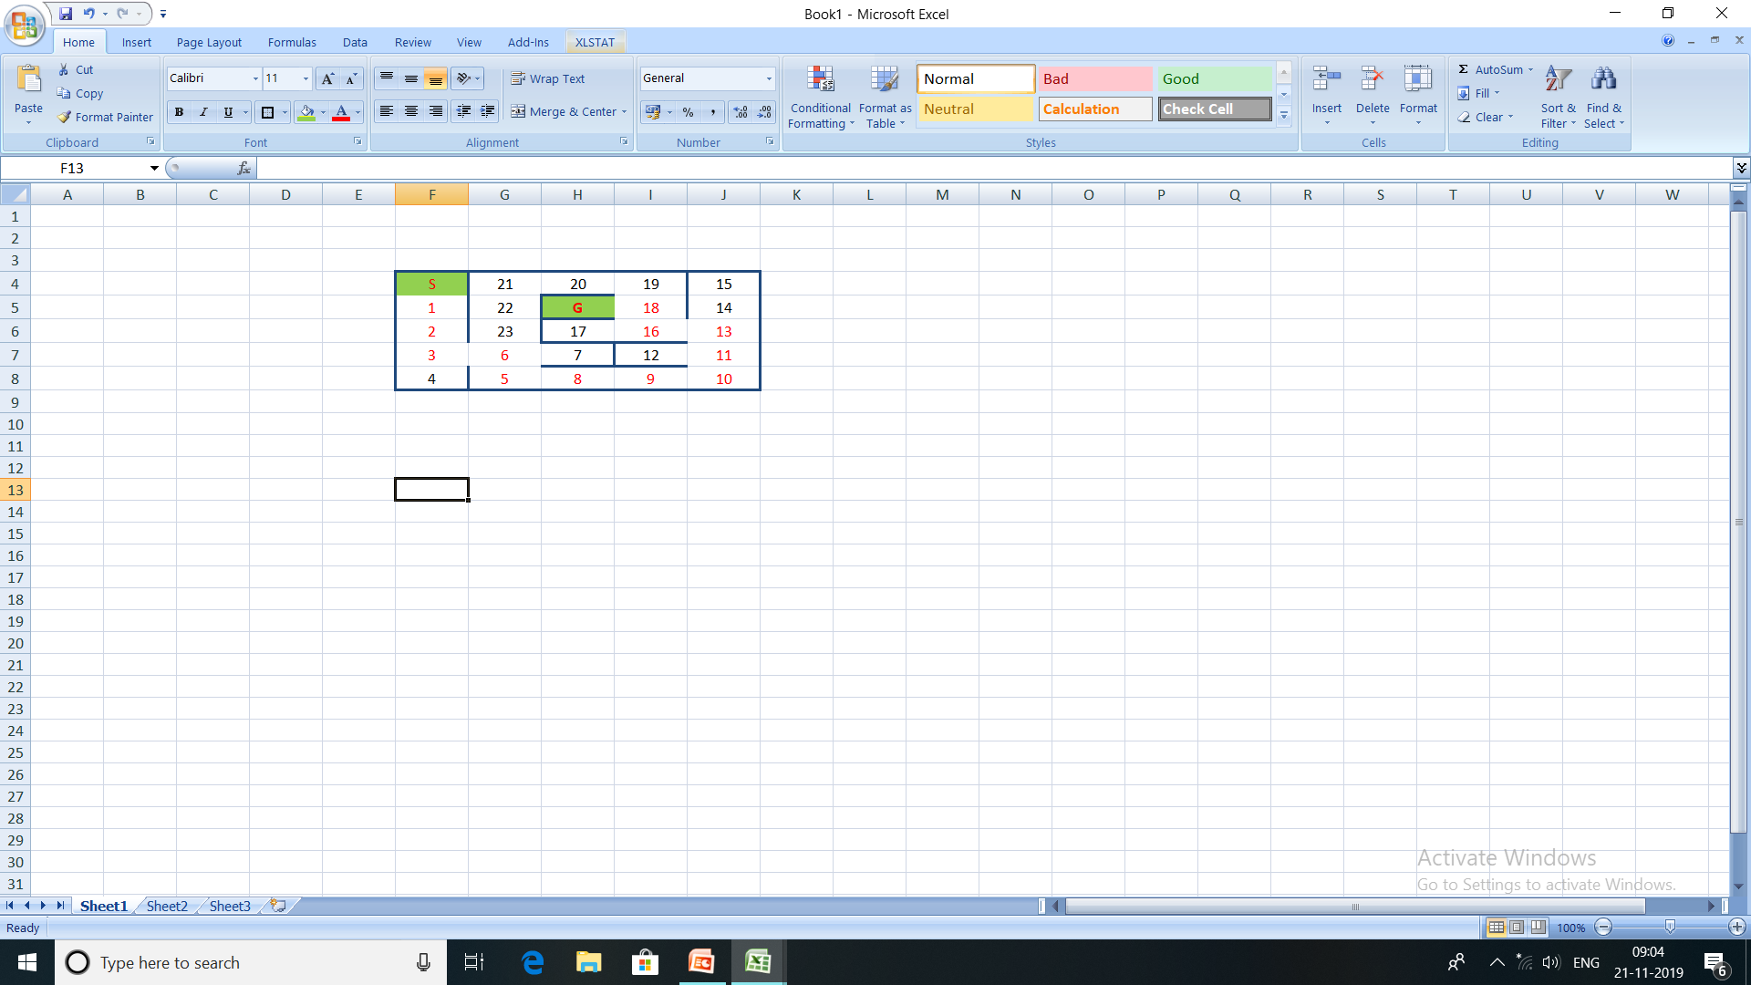
APPLICATION: MAZE GAME
BFS SOLUTION?
S-1-2-3-5-8-10-12-14-16-19-G
SEARCH SOLUTION FOUND IN 12 STEPS
DFS SOLUTION?
S-1-2-3-6-5-8-9-10-11-13-16-18-G
SEARCH SOLUTION FOUND IN 14 STEPS

Slide 16
APPLICATION: MAZE GAME
BFS SOLUTION?
S-1-2-3-5-8-10-12-14-16-19-G
SEARCH SOLUTION FOUND IN 12 STEPS
S
5
15
19
6
7
8
1
17
18
G
21
9
10
2
20
21
11
12
x
3
x
19
5
4
13
14
16
15
19

Slide 17
APPLICATION: MAZE GAME
BFS SOLUTION?
S-1-2-3-5-8-10-12-14-16-19-G
SEARCH SOLUTION FOUND IN 12 STEPS
S
5
15
19
6
7
8
1
17
18
G
21
9
10
2
20
21
11
12
x
3
x
19
5
4
13
14
16
15
19

Slide 18
Blind Search : Uniform Cost Search
This algorithm comes into play when a different cost is available for each edge.
The primary goal of the uniform-cost search is to find a path to the goal node which has the lowest cumulative cost.
Uniform-cost search expands nodes according to their path costs form the root node. It can be used to solve any graph/tree where the optimal cost is in demand.
A uniform-cost search algorithm is implemented by the priority queue.
It gives maximum priority to the lowest cumulative cost.
Uniform cost search is equivalent to BFS algorithm if the path cost of all edges is the same.

Slide 19
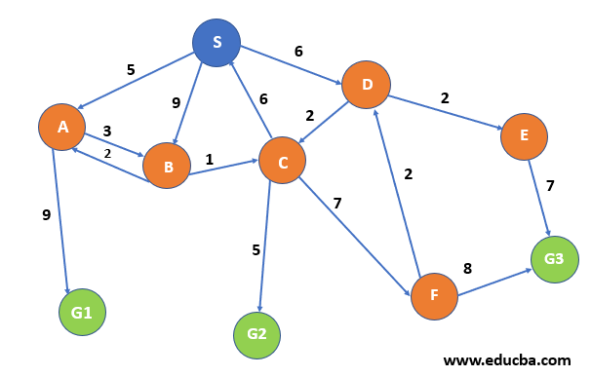
Uniform Cost Search - Example

Slide 20
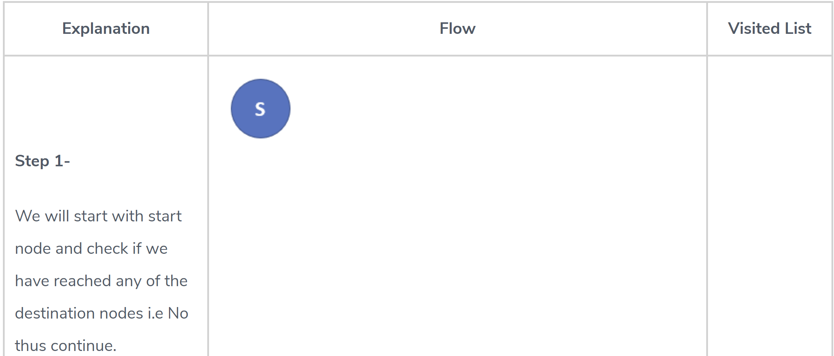
Uniform Cost Search - Example

Slide 21
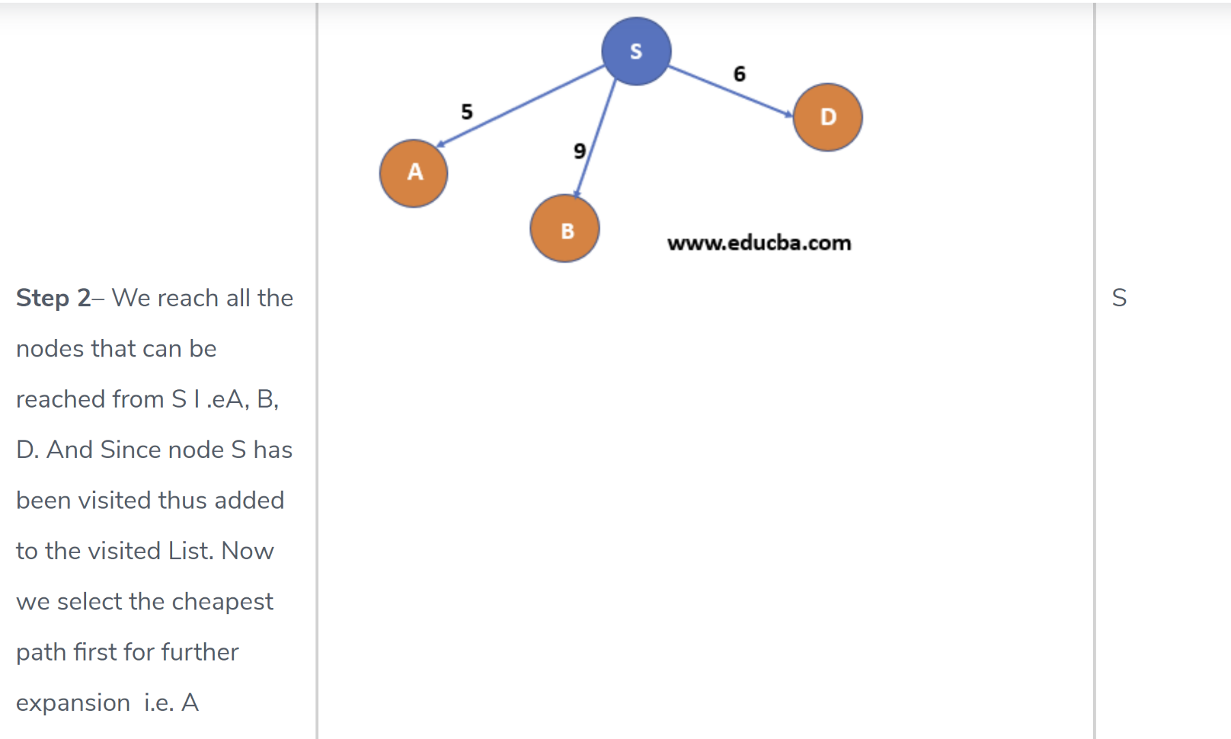
Uniform Cost Search - Example

Slide 22
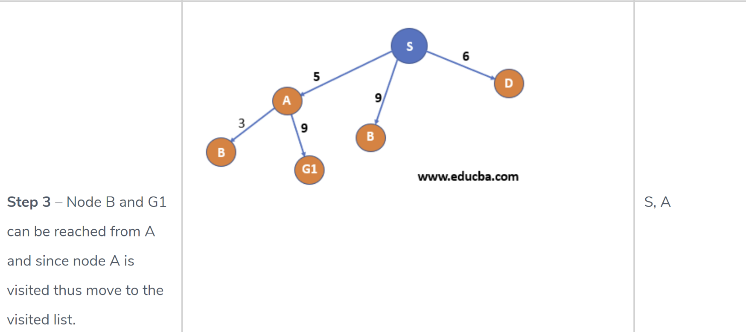
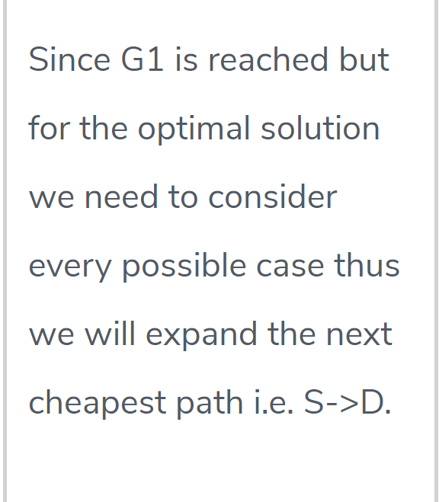
Uniform Cost Search - Example

Slide 23
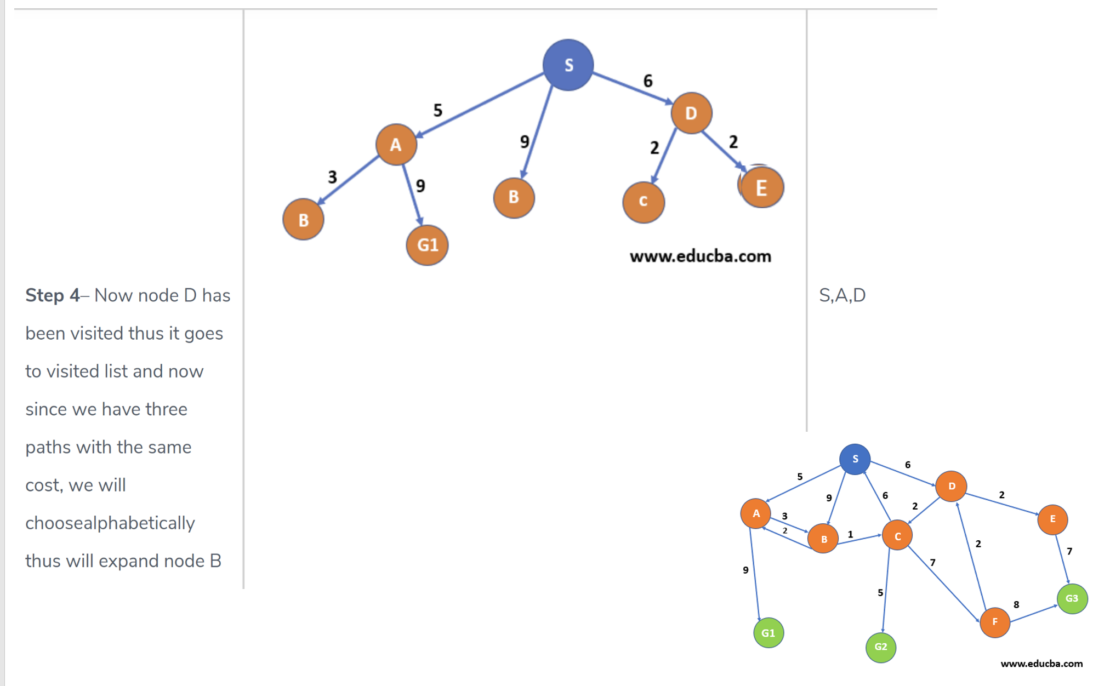
Uniform Cost Search - Example

Slide 24
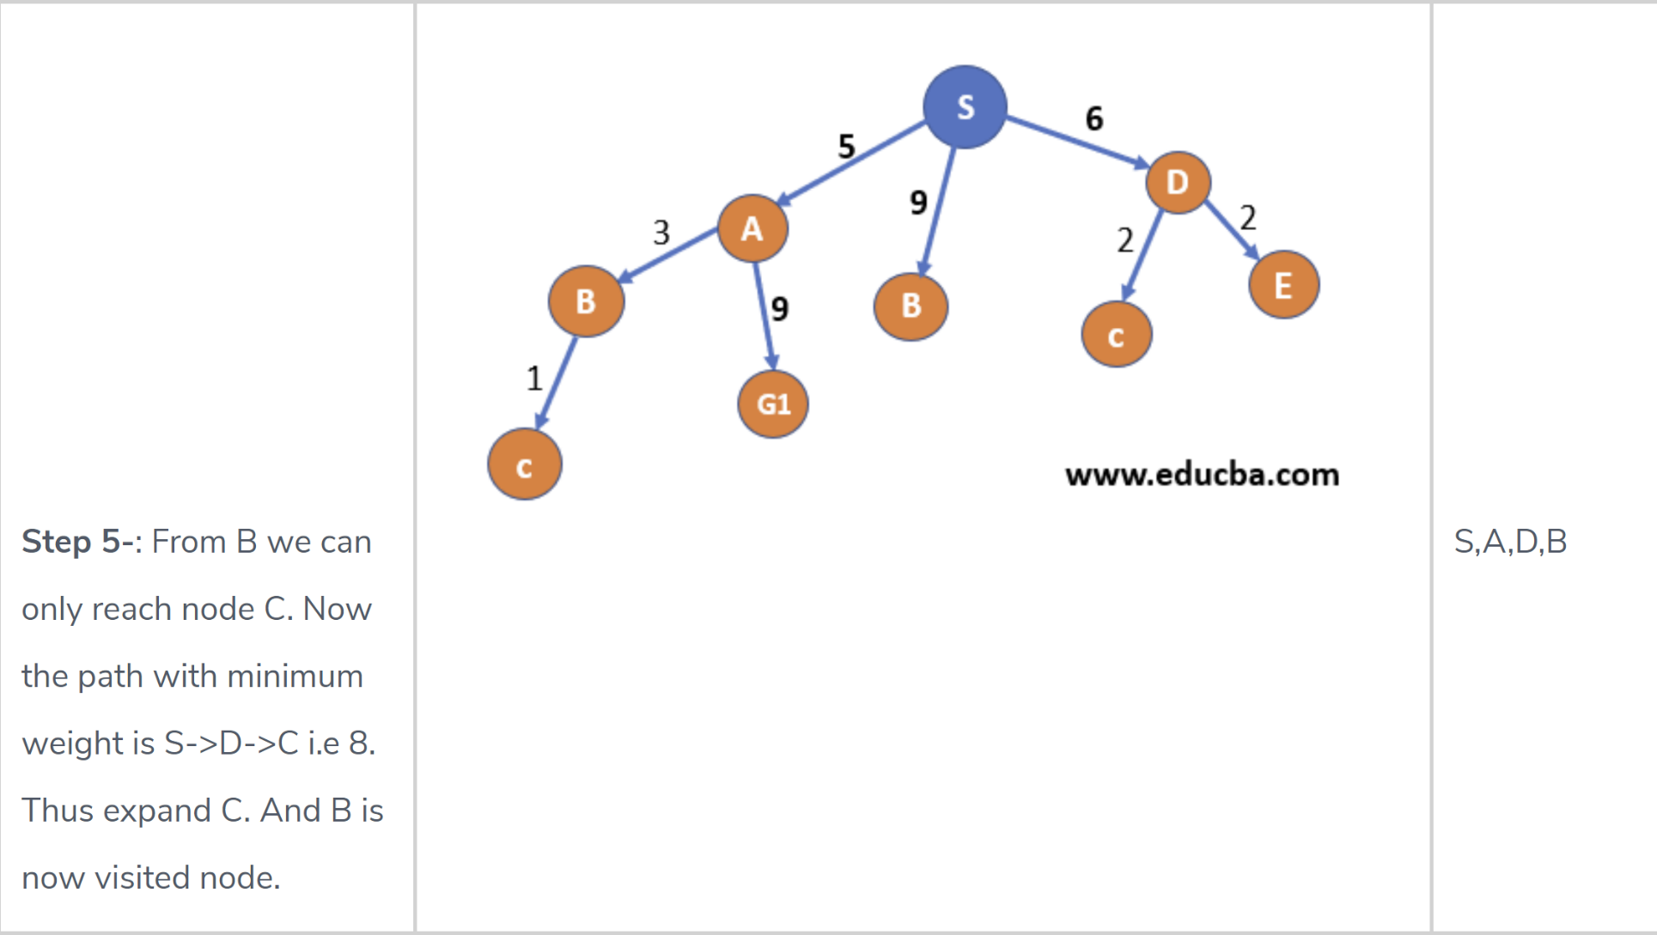
Uniform Cost Search - Example

Slide 25
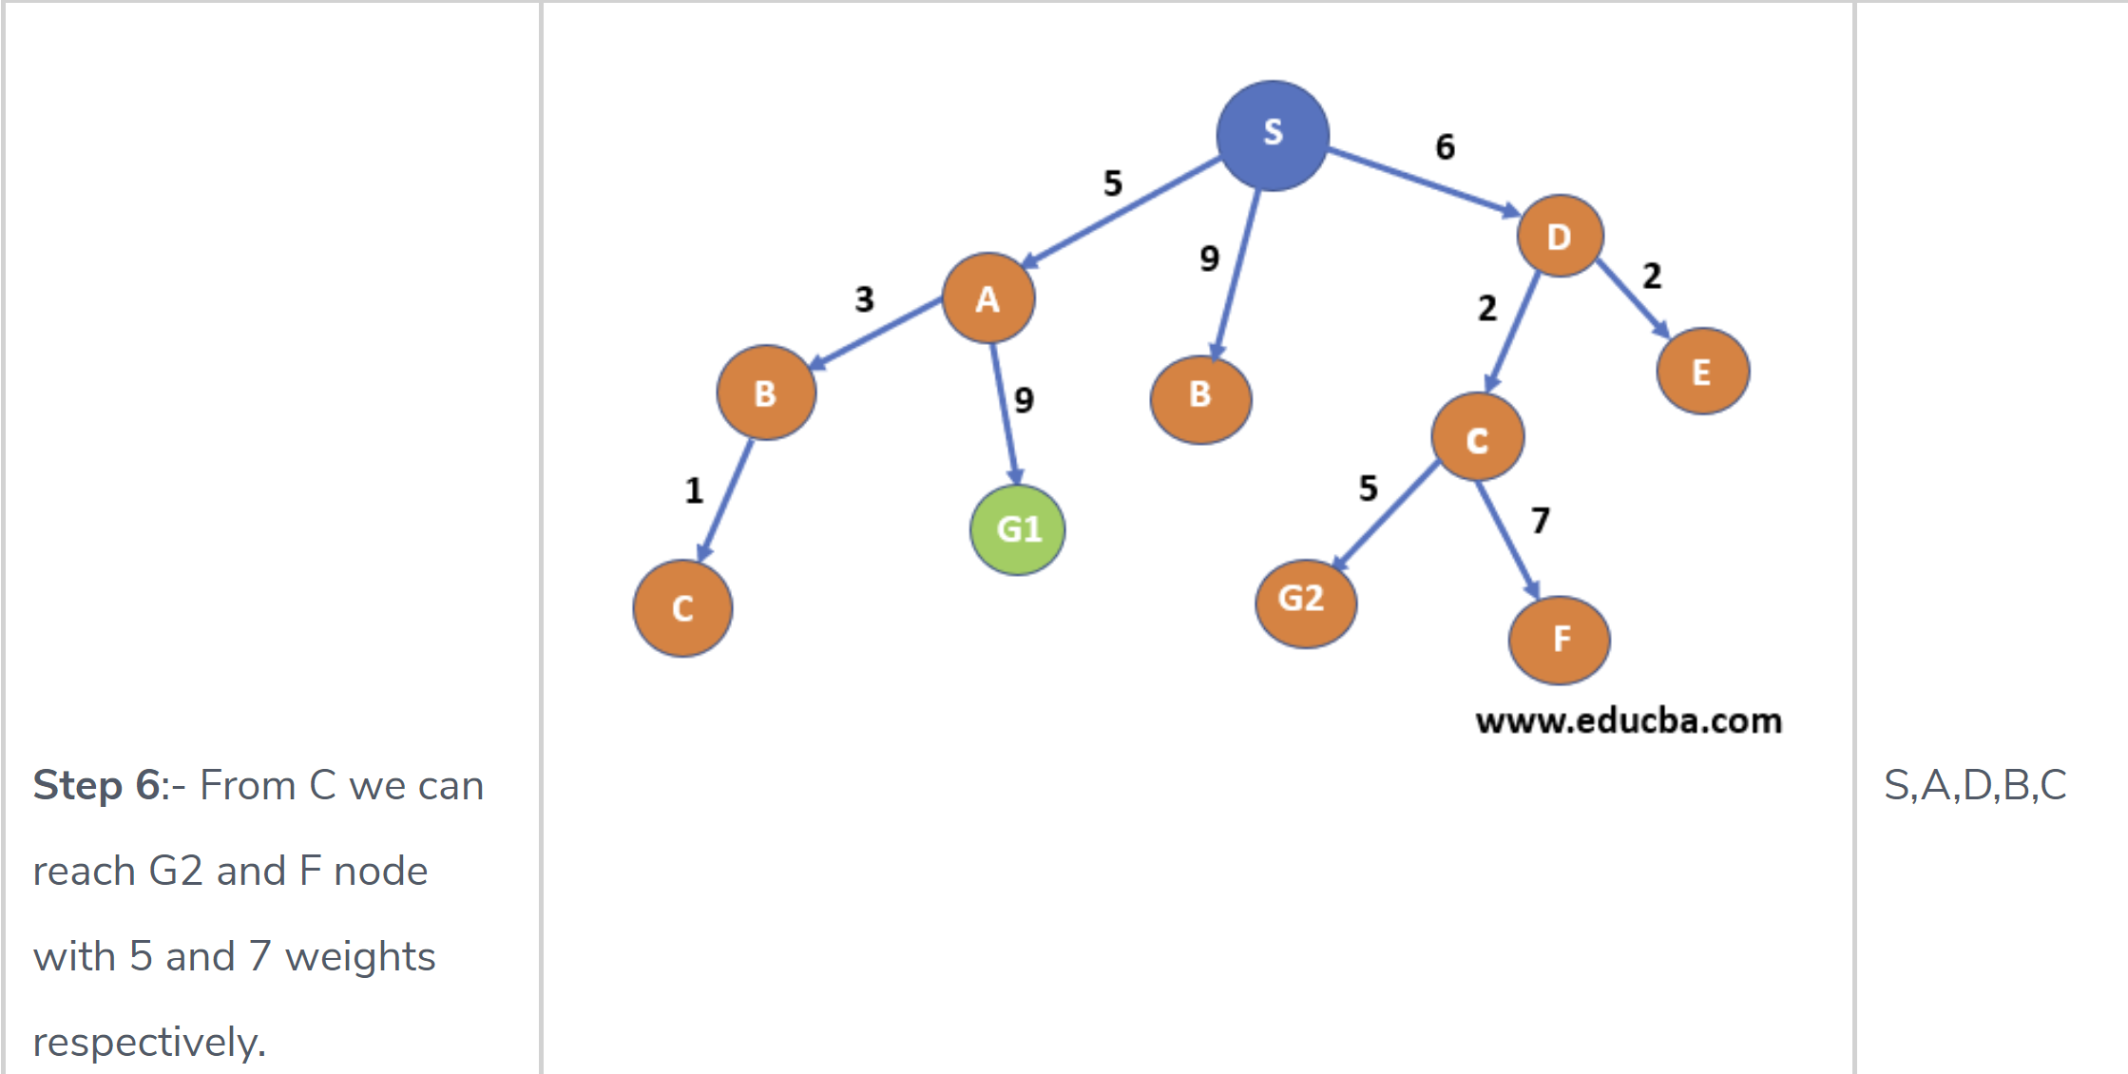
Uniform Cost Search - Example

Slide 26
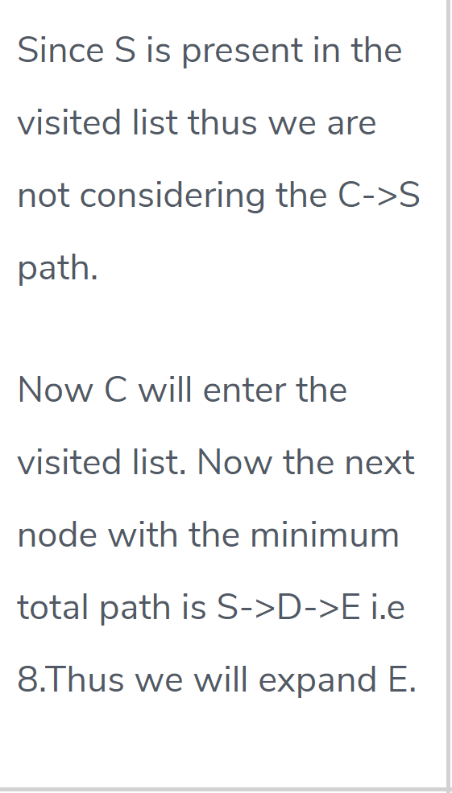
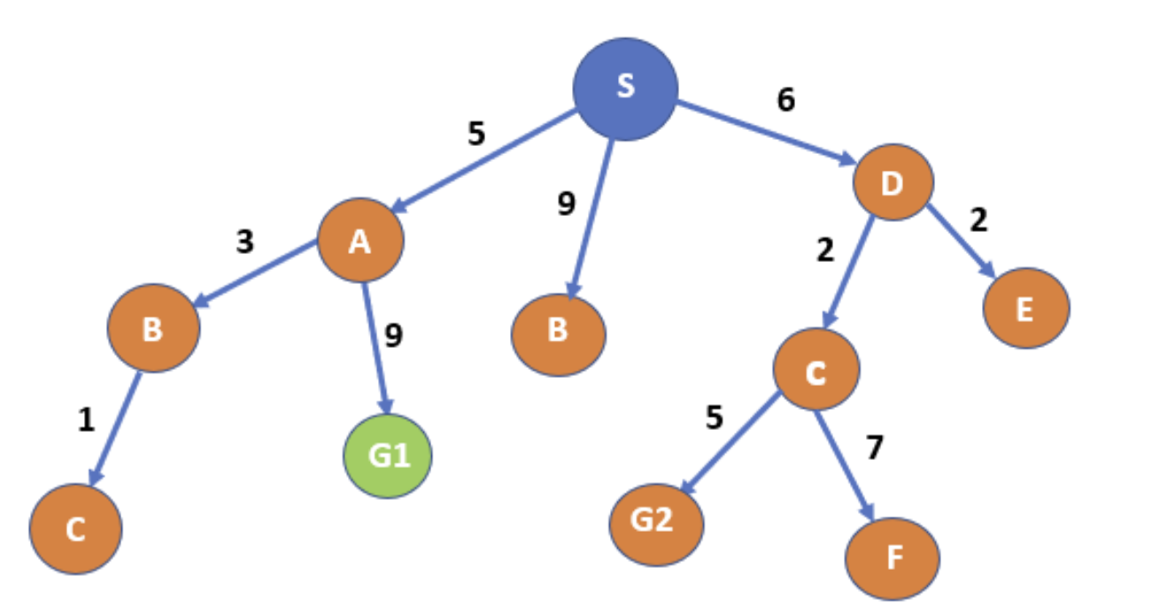
Uniform Cost Search - Example

Slide 27
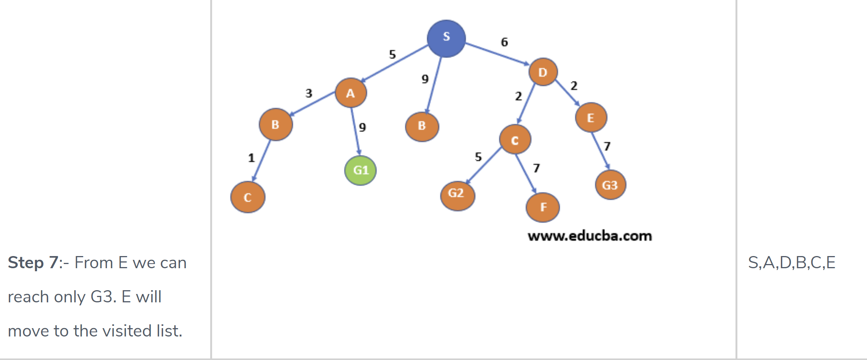
Uniform Cost Search - Example

Slide 28
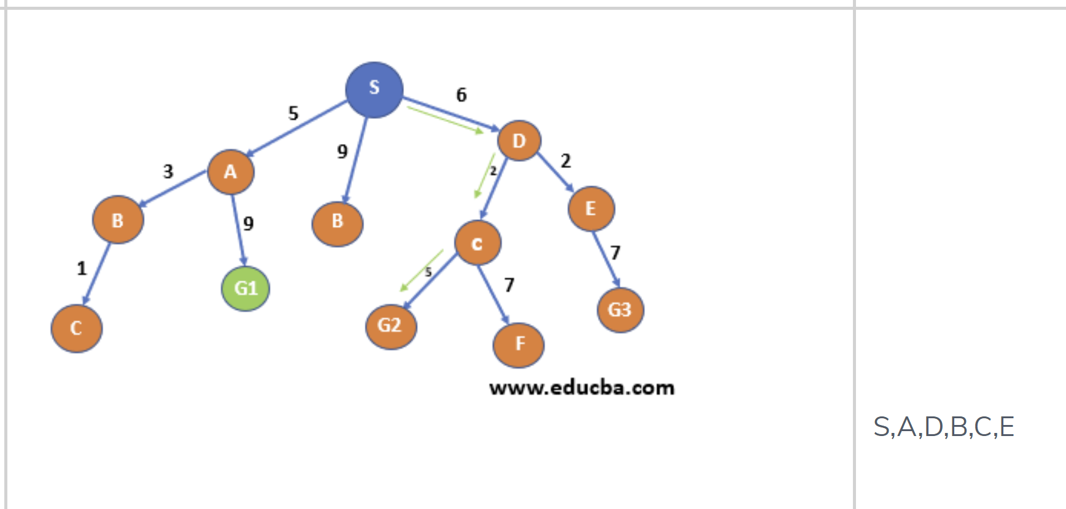
Uniform Cost Search - Example
Minimum is S->D->C->G2
And also G2 is one of the destination nodes thus we found our path.
In this way we can find the path with the minimum cumulative cost from a start node to ending node – S->D->C->G2 with cost total cost as 13(marked with green color).

Slide 29
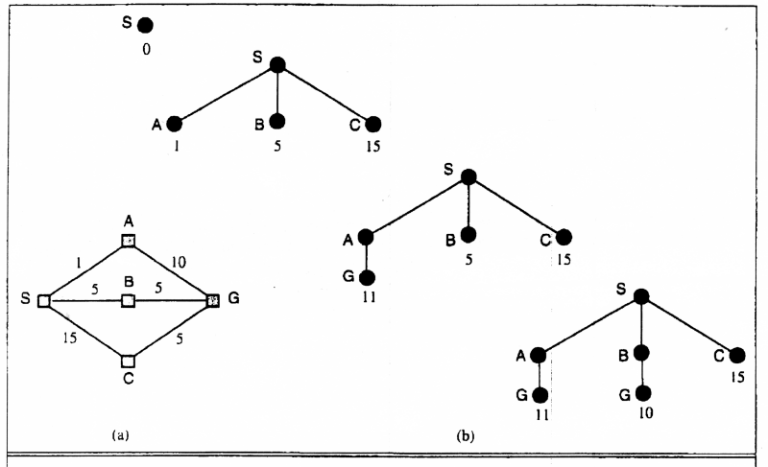
Uniform Cost Search
Implementation: fringe = queue ordered by path cost
Equivalent to breadth-first if all step costs all equal.
Breadth-first is only optimal if step costs is increasing with depth.
(e.g. constant). Can we guarantee optimality for any step cost?
Uniform-cost Search: Expand node with smallest path cost g(n).

Slide 30
Blind strategies UCS
Uniform Cost Search
Search Methods
Uniform-cost search strategy
Expands the node with the lowest cost from the start node
rst.ª
Completeness: yes, if cost of each step ≥ s > 0.
Optimality: same as above nodes are expanding in increasing order of cost.
Time and space complexity: O(b^{1+ƒC ∗/s¶}).^{b}
a
If all step costs are equal, UCS=BFS. C ∗ cost of optimal solution
b

Slide 31
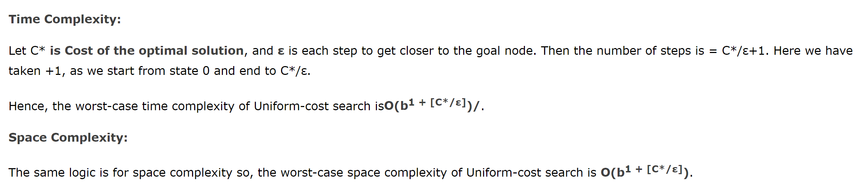
Blind strategies UCS
Uniform Cost Search
Search Methods

Slide 32
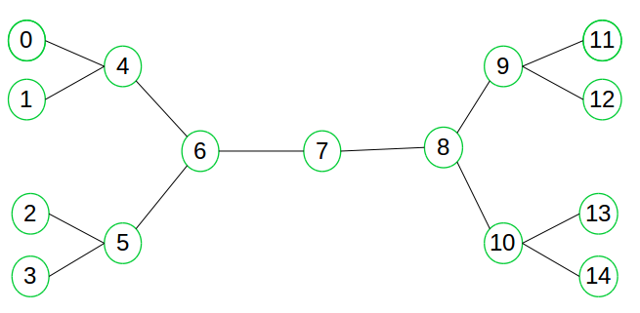
Blind search -Bidirectional Search

Slide 33




Summary of Blind Search Algorithms
Criterion | Breadth- First | Depth- First
Time | _{b}d | _{b}m
Space | _{b}d | bm
Optimal? | Yes | No
Complete? | Yes | No
b: branching factor
d: solution depth
m: maximum depth

Slide 34
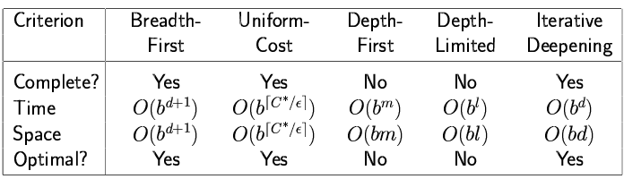
Summary of Blind Search Algorithms
Algorithm | Space | Time | Complete | Optimal
BFS | Theta (b^d) | Theta(b^d) | Yes | Yes
DFS | Theta(d) | Theta(b^m) | No | No
UCS | Theta(b^ (ceil(C*/e)) | Theta(b^d) | Yes | Yes
DLS | Theta(l) | Theta(b^l) | No | No
IDS | Theta(d) | Theta(b^d) | Yes | Yes

Slide 35
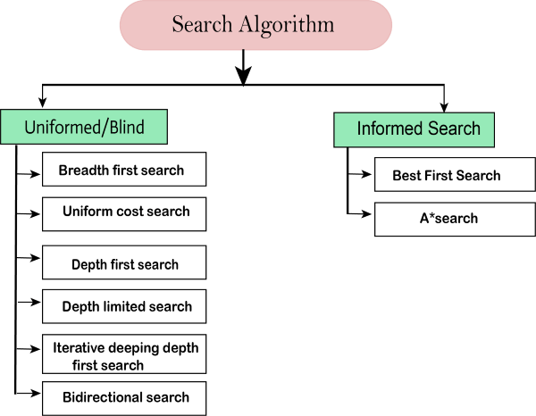
Summary of Search Algorithms

Slide 36
Unit 2 List of Topics
Searching techniques – Uninformed search – General search Algorithm
Uninformed search Methods – Breadth First Search
Uninformed search Methods – Depth First Search
Uninformed search Methods – Depth limited Search
Uniformed search Methods- Iterative Deepening search
Bi-directional search
Informed search- Generate and test, Best First search
Informed search-A* Algorithm
AO* search
Local search Algorithms-Hill Climbing, Simulated Annealing
Local Beam Search
Genetic Algorithms
Adversarial search Methods-Game playing-Important concepts
Game playing and knowledge structure.
Game as a search problem-Minimax Approach
Minimax Algorithm
Alpha beta pruning
Game theory problems

Slide 37
Informed Search Algorithms
Generate and Test
Best-first search
Greedy best-first search
A* search
Heuristics

Slide 38
Generate-and-test
Very simple strategy - just keep guessing.
do while goal not accomplished
generate a possible solution
test solution to see if it is a goal
Heuristics may be used to determine the specific rules for solution generation.
Notes:
Generating a solution may mean moving in the state space, or perhaps constructing a path through the state space. The path may end at a goal state, in which case we are done.
If a systematic mechanism for generation is used the algorithm can always find the best solution.
Random generation may work in some domains.
Depth first search since complete solutions are generated before they can be tested.

Slide 39
Example - Traveling Salesman Problem (TSP)
Generate-and-test
Traveler needs to visit n cities.
Know the distance between each pair of cities.
Want to know the shortest route that visits all the cities once.
n=80 will take millions of years to solve exhaustively!

Slide 40
TSP Example
Generate-and-test
A
B
6
1
2
5
3
D
C
4
Notes:
ABCD = 18
BACD = 13 - take it
ABCD = 18 - nope
BCAD - 11 - take it (is the optimum)
CBAD - 18
BACD - 13
BCDA - 18
DCAB - 13 nope

Slide 41
Generate-and-test Example
TSP - generation of possible solutions is done in lexicographical order of cities:
1. A - B - C - D
2. A - B - D - C
3. A - C - B - D
4. A - C - D - B
...
A
B
C
D
B
C
D
C
D
B
D
C
B
D
C
D
B
B
C
Notes:
Characteristics with generate-and-test:
Requires that an entire possible solution is generated at each step, which may
be expensive
It may be difficult to develop a generation scheme that provides a
good order.
The big problem is that the algorithm is blind - it does not make use of any
knowledge that becomes available during the search.
1. Can modify to use brand-and-bound techniques to skip some solutions.
2. Perhaps we can use information about the likelyhood of success to change
the generated possible solutions.
IMPORTANT: TSP is a bad example because it is hard to see the state space. Consider a problem like the water jug problem and describe how this algorithm would work in that domain.

Slide 42
Best First Search Algorithms
Idea: use an evaluation function f(n) for each node
f(n) provides an estimate for the total cost.
Expand the node n with smallest f(n).
Implementation:
Order the nodes in fringe increasing order of cost.
Special cases:
greedy best-first search
A* search

Slide 43
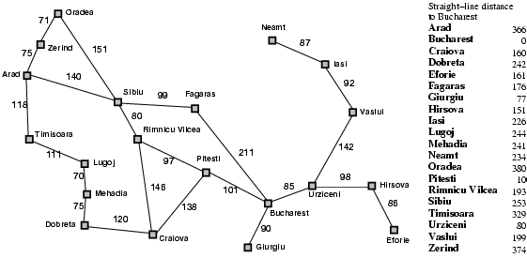
Romania with straight-line dist.

Slide 44
Greedy best-first search
f(n) = estimate of cost from n to goal
e.g., f(n) = straight-line distance from n to Bucharest
Greedy best-first search expands the node that appears to be closest to goal.

Slide 45

Greedy best-first search example

Slide 46

Greedy best-first search example

Slide 47

Greedy best-first search example

Slide 48

Greedy best-first search example

Slide 49
GBFS is not complete
d
c
b
g
a
goal state
start state
f(n) = straightline distance

Slide 50
Properties of greedy best-first search
Complete? No – can get stuck in loops.
Time? O(b^{m}), but a good heuristic can give dramatic improvement
Space? O(b^{m}) - keeps all nodes in memory
Optimal? No
e.g. Arad→Sibiu→Rimnicu Virea→Pitesti→Bucharest is shorter!

Slide 51
Unit 2 List of Topics
Searching techniques – Uninformed search – General search Algorithm
Uninformed search Methods – Breadth First Search
Uninformed search Methods – Depth First Search
Uninformed search Methods – Depth limited Search
Uniformed search Methods- Iterative Deepening search
Bi-directional search
Informed search- Generate and test, Best First search
Informed search-A* Algorithm
AO* search
Local search Algorithms-Hill Climbing, Simulated Annealing
Local Beam Search
Genetic Algorithms
Adversarial search Methods-Game playing-Important concepts
Game playing and knowledge structure.
Game as a search problem-Minimax Approach
Minimax Algorithm
Alpha beta pruning
Game theory problems

Slide 52
A* search
Idea: avoid expanding paths that are already expensive
Evaluation function f(n) = g(n) + h(n)
g(n) = cost so far to reach n
h(n) = estimated cost from n to goal
f(n) = estimated total cost of path through n to goal
Best First search has f(n)=h(n)
Uniform Cost search has f(n)=g(n)

Slide 53
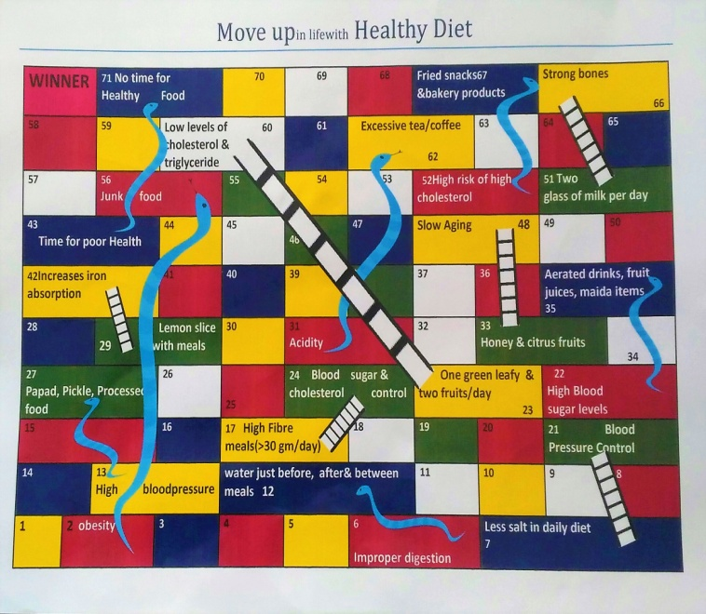
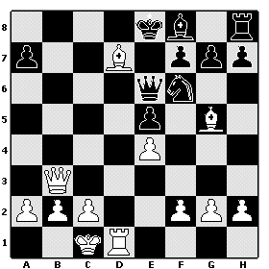
Applications of Heuristic Search : A* Algorithm
Widely known algorithm – (pronounced as “A star” search).
Evaluates nodes by combining g(n) “cost to reach the node” and h(n) “cost to get to the goal”
f(n) = g(n) + h(n), f(n) → estimated cost of the cheapest solution.
Complete and optimal ~ since evaluates all paths.

Slide 54
Heuristic Search : A* Algorithm
Path cost for S-D-G
S
:10
f(S) = g(S) + h(S) = 0 + 10 → 10 f(D) = (0+3) + 9 → 12 f(G) = (0+3+3) + 0 → 6
Total path cost = f(S)+f(D)+f(G)→ 28
2
3
A
D
:9
:8
5
2
3
1
Path cost for S-A-G’
E
G’
G
H
f(S) = 0 + 10 → 10 f(A) = (0+2) + 8 → 10 f(G’) = (0+2+2) + 0 → 4
Total path cost = f(S)+f(A)+f(G’)→ 24
:4
:0
:0
:3
* Path S-A-G’ is chosen = Lowest cost

Slide 55

Application of Heuristic Search : A* Algorithm – Snake & Ladder
12 h(n)=0 | 11 | 10 g(n)=1, h(n)=2, f(n)=3 | 9g(n)=8, h(n)=8, f(n)=16
8 | 7 | 6 | 5
1 g(n)=0, h(n)=11, f(n)=11 | 2 g(n)=1, h(n)=2, f(n)=3 | 3 g(n)=2, h(n)=9, f(n)=11 | 4 g(n)=3, h(n)=8, f(n)=11
1 | 2 (10) | 3 | 4 | 5 | 6 | 7
2 (10) | 3 | 4 | 5 | 6 | 7 | 8
3 | 4 | 5 | 6 | 7 | 8 | 9 (4)
4 | 5 | 6 | 7 | 8 | 9 (4) | 10
5 | 6 | 7 | 8 | 9 (4) | 10 | 11
6 | 7 | 8 | 9 (4) | 10 | 11 | 12
7 | 8 | 9 (4) | 10 | 11 | 12 | X
8 | 9 (4) | 10 | 11 | 12 | X
9 (4) | 10 | 11 | 12 | X
10 | 11 | 12 | X
11 | 12 | X
12 | X

Slide 56

A* search example

Slide 57

A* search example

Slide 58

A* search example

Slide 59

A* search example

Slide 60

A* search example

Slide 61

A* search example

Slide 62
try yourself !
A
6
D
1
F
straight-line distances
3
1
h(S-G)=10
h(A-G)=7
h(D-G)=1
h(F-G)=1
h(B-G)=10
h(E-G)=8
h(C-G)=20
h(G-G)=0
S
2
4
8
G
B
E
1
20
C
The graph above shows the step-costs for different paths going from the start (S) to
the goal (G). On the right you find the straight-line distances.
Draw the search tree for this problem. Avoid repeated states.
Give the order in which the tree is searched (e.g. S-C-B...-G) for A* search.
Use the straight-line dist. as a heuristic function, i.e. h=SLD, and indicate for each node visited what the value for the evaluation function, f, is.

Slide 63
Admissible heuristics
A heuristic h(n) is admissible if for every node n,
h(n) ≤ h*(n), where h*(n) is the true cost to reach the goal state from n.
An admissible heuristic never overestimates the cost to reach the goal, i.e., it is optimistic
Example: h_{SLD}(n) (never overestimates the actual road distance)
Theorem: If h(n) is admissible, A* using TREE-SEARCH is optimal

Slide 64
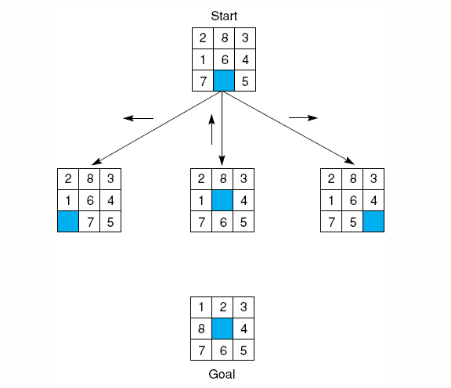
Admissible heuristics – 8 Puzzle Problem
Try it out!
START
1 | 2 | 3
7 | 8 | 4
6 |  | 5
GOAL
1 | 2 | 3
8 |  | 4
7 | 6 | 5

Slide 65
Admissible heuristics – 8 Puzzle Problem
START
1 | 2 | 3
7 | 8 | 4
6 |  | 5
START
1 | 2 | 3
7 | 8 | 4
6 |  | 5
START
1 | 2 | 3
7 |  | 4
6 | 8 | 5
START
1 | 2 | 3
7 | 8 | 4
6 | 5
START
1 | 2 | 3
7 | 8 | 4
 | 6 | 5
GOAL
1 | 2 | 3
8 |  | 4
7 | 6 | 5
H=5
H=4
H=6

Slide 66

Admissible heuristics
E.g., for the 8-puzzle:
h₁(n) = number of misplaced tiles
h₂(n) = total Manhattan distance
(i.e., no. of squares from desired location of each tile)
h₁(S) = ?
h₂(S) = ?

Slide 67
Evaluation of Search Algorithms
Completeness
Is the algorithm guaranteed to nd a solution if one exists?
Optimality
When the algorithm nds a solution, is this the optimal one?
Time complexity
How long does it take to nd a solution?ª
ª Often measured as number of nodes generated during search.
Space complexity
How much memory is needed to perform the search?ª
ª Often measured as maximum number of nodes stored in memory.

Slide 68
Unit 2 List of Topics
Searching techniques – Uninformed search – General search Algorithm
Uninformed search Methods – Breadth First Search
Uninformed search Methods – Depth First Search
Uninformed search Methods – Depth limited Search
Uniformed search Methods- Iterative Deepening search
Bi-directional search
Informed search- Generate and test, Best First search
Informed search-A* Algorithm
AO* search
Local search Algorithms-Hill Climbing, Simulated Annealing
Local Beam Search
Genetic Algorithms
Adversarial search Methods-Game playing-Important concepts
Game playing and knowledge structure.
Game as a search problem-Minimax Approach
Minimax Algorithm
Alpha beta pruning
Game theory problems

Slide 69
Algorithm AO*
E.g., for the 8-puzzle:
h₁(n) = number of misplaced tiles
h₂(n) = total Manhattan distance
(i.e., no. of squares from desired location of each tile)
h₁(S) = ?
h₂(S) = ?
Initialize: Set G* = {s}, f(s) = h(s)
If s ∈ T, label s as SOLVED
Terminate: If s is SOLVED, then terminate
Select: Select a non-terminal leaf node n from the marked sub-tree below s in G*
Expand: Make explicit the successors of n
For each successor, m, not already in G*:
Set f(m) = h(m)
If m is a terminal node, label m as SOLVED
Cost Revision: Call cost-revise(n)
Loop: Go To Step 2.

Slide 70
Cost Revision in AO*: cost-revise(n)
E.g., for the 8-puzzle:
h₁(n) = number of misplaced tiles
h₂(n) = total Manhattan distance
(i.e., no. of squares from desired location of each tile)
h₁(S) = ?
h₂(S) = ?
Create Z = {n}
If Z = { } return
Select a node m from Z such that m has no descendants in Z
If m is an AND node with successors r₁, r₂, … r_{k}:
Set f(m) = Σ [ f(r_{i}) + c(m, r_{i}) ]
Mark the edge to each successor of m
If each successor is labeled SOLVED, then label m as SOLVED
If m is an OR node with successors r₁, r₂, … r_{k}:
Set f(m) = min { f(r_{i}) + c(m, r_{i}) }
Mark the edge to the best successor of m
If the marked successor is labeled SOLVED, label m as SOLVED
If the cost or label of m has changed, then insert those parents of m into Z for which m is a marked successor
Go to Step 2.

Slide 71
Searching OR Graphs
E.g., for the 8-puzzle:
h₁(n) = number of misplaced tiles
h₂(n) = total Manhattan distance
(i.e., no. of squares from desired location of each tile)
h₁(S) = ?
h₂(S) = ?
How does AO* fare when the graph has only OR nodes?
What are the roles of lower-bound and upper-bound estimates?
Pruning criteria: LB > UB
Searching Game Trees
Consider an OR tree with two types of OR nodes, namely Min nodes and Max nodes
In Min nodes we select the minimum cost successor
In Max nodes we select the maximum cost successor
Terminal nodes are winning or loosing states
It is often infeasible to search up to terminal nodes
We use heuristic costs to compare non-terminal nodes

Slide 72
Shallow and Deep Pruning
E.g., for the 8-puzzle:
h₁(n) = number of misplaced tiles
h₂(n) = total Manhattan distance
(i.e., no. of squares from desired location of each tile)
h₁(S) = ?
h₂(S) = ?
ROOT
ROOT
A
10
B
10
F
Max node
14
C
D
G
Min node
5
E
Shallow Cut-off
Deep Cut-off

Slide 73
Unit 2 List of Topics
Searching techniques – Uninformed search – General search Algorithm
Uninformed search Methods – Breadth First Search
Uninformed search Methods – Depth First Search
Uninformed search Methods – Depth limited Search
Uniformed search Methods- Iterative Deepening search
Bi-directional search
Informed search- Generate and test, Best First search
Informed search-A* Algorithm
AO* search
Local search Algorithms-Hill Climbing, Simulated Annealing
Local Beam Search
Genetic Algorithms
Adversarial search Methods-Game playing-Important concepts
Game playing and knowledge structure.
Game as a search problem-Minimax Approach
Minimax Algorithm
Alpha beta pruning
Game theory problems

Slide 74
Local search algorithms

Slide 75
Local search algorithms
In many optimization problems, the path to the goal is irrelevant; the goal state itself is the solution
State space = set of "complete" configurations
Find configuration satisfying constraints, e.g., n-queens
In such cases, we can use local search algorithms
keep a single "current" state, try to improve it.
Very memory efficient (only remember current state)

Slide 76
Types of Local Search
Hill-climbing Search
Simulation Annealing Search

Slide 77
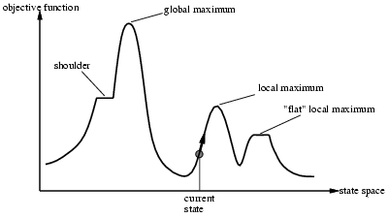
Terminology of Local Search

Slide 78
Local search algorithms
Hill Climbing
Searching for a goal state = Climbing to the top of a hill.
Generate‐and‐test + direction to move.
Heuristic function to estimate how close a given state is to a goal state.

Slide 79
Hill Climbing
Algorithm
Evaluate the initial state.
Loop until a solution is found or there are no new operators left to be applied:
Select and apply a new operator
Evaluate the new state:
goal → quit
better than current state → new current state

Slide 80
Steepest Ascent Hill Climbing
Considers all the moves from the current state.
Selects the best one as the next state.
Steepest-Ascent Hill Climbing
current ← start node
loop do
neighbor ← a highest-valued successor of current
if neighbor.Value <= current.Value then return current.State
current ← neighbor
end loop

Slide 81
Steepest Ascent/Descent Hill Climbing
current
6
4
10
3
2
8
What if current had a value of 12?

Slide 82
Hill Climbing Example
A local heuristic function
Count +1 for every block that sits on the correct thing. The goal state has the value +8.
Count -1 for every block that sits on an incorrect thing. In the initial state blocks C, D, E, F, G, H count +1 each. Blocks A, B count -1 each , for the total of +4.
Move 1 gives the value +6 (A is now on the correct support). Moves 2a and 2b both give +4 (B and H are wrongly situated). This means we have a local maximum of +6.

Slide 83
Hill Climbing Example
A global heuristic function
Count +N for every block that sits on a correct stack of N things. The goal state has the value +28.
Count -N for every block that sits on an incorrect stack of N things. That is, there is a large penalty for blocks tied up in a wrong structure.
In the initial state C, D, E, F, G, H count -1, -2, -3, -4, -5, -6. A counts -7 , for the total of -28.

Slide 84
Hill Climbing Example
Move 1 gives the value -21 (A is now on the correct support).
Move 2a gives -16, because C, D, E, F, G, H count -1, -2, -3, -4, -5, -1.
Move 2b gives -15, because C, D, E, F, G count -1, -2, -3, -4, -5.
There is no local maximum!
Moral: sometimes changing the heuristic function is all we need.

Slide 85
Hill-climbing search
Problem: depending on initial state, can get stuck in local maxima

Slide 86

Hill Climbing: Disadvantages
Local maximum
A state that is better than all of its neighbours, but not better than some other states far away.
Plateau
A flat area of the search space in which all neighbouring states have the same value.
Ridge
The orientation of the high region, compared to the set of available moves, makes it impossible to climb up. However, two moves executed serially may increase the height.

Slide 87
Hill Climbing: Disadvantages
Ways Out
Backtrack to some earlier node and try going in a different direction.
Make a big jump to try to get into a new solution.
Moving in several directions at once.

Slide 88
Unit 2 List of Topics
Searching techniques – Uninformed search – General search Algorithm
Uninformed search Methods – Breadth First Search
Uninformed search Methods – Depth First Search
Uninformed search Methods – Depth limited Search
Uniformed search Methods- Iterative Deepening search
Bi-directional search
Informed search- Generate and test, Best First search
Informed search-A* Algorithm
AO* search
Local search Algorithms-Hill Climbing, Simulated Annealing
Local Beam Search
Genetic Algorithms
Adversarial search Methods-Game playing-Important concepts
Game playing and knowledge structure.
Game as a search problem-Minimax Approach
Minimax Algorithm
Alpha beta pruning
Game theory problems

Slide 89
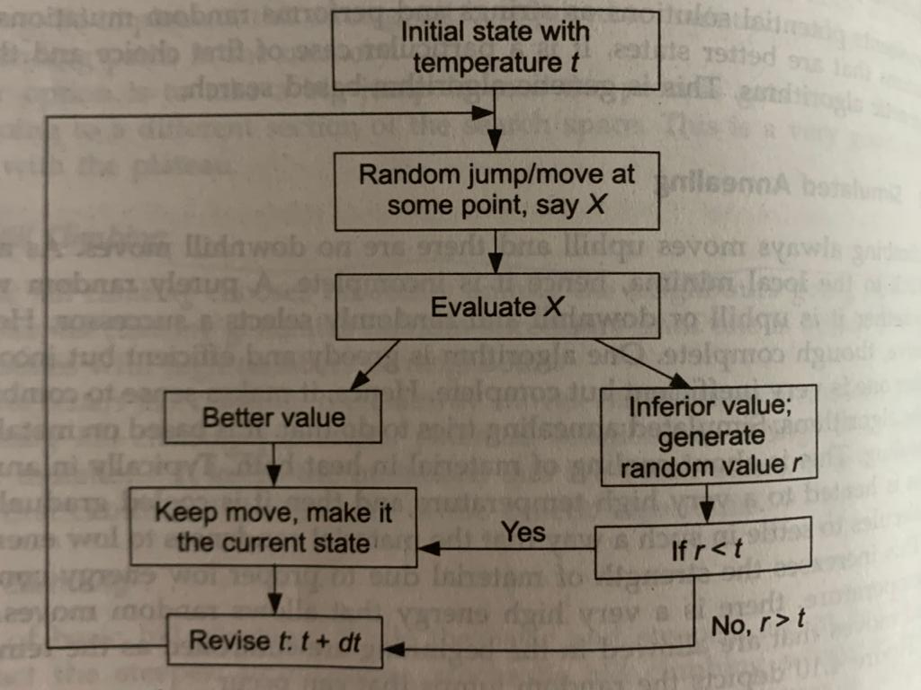
Simulated Annealing – Basic Steps

Slide 90
Simulated annealing search
Idea: escape local maxima by allowing some "bad" moves but gradually decrease their frequency.
This is like smoothing the cost landscape.
One can prove: If T decreases slowly enough, then simulated annealing search will find a global optimum with probability approaching 1 (however, this may take VERY long)

Slide 91
Simulated annealing search
A variation of hill climbing in which, at the beginning of the process, some downhill moves may be made.
To do enough exploration of the whole space early on, so that the final solution is relatively insensitive to the starting state.
Lowering the chances of getting caught at a local maximum, or plateau, or a ridge.

Slide 92
Simulated annealing search
Physical Annealing
Physical substances are melted and then gradually cooled until some solid state is reached.
The goal is to produce a minimal‐energy state.
Annealing schedule: if the temperature is lowered sufficiently slowly, then the goal will be attained.
Nevertheless, there is some probability for a transition to a higher energy state: e^{−ΔE/kT}.

Slide 93
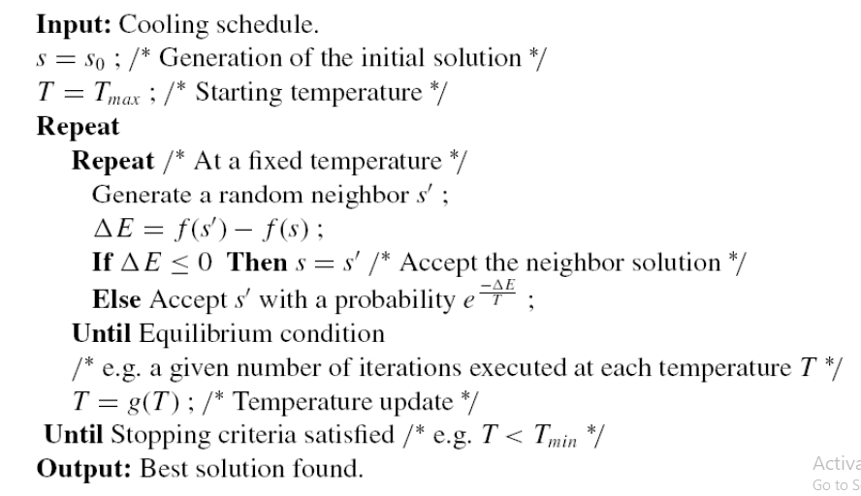
Simulated annealing algorithm
80

Slide 94
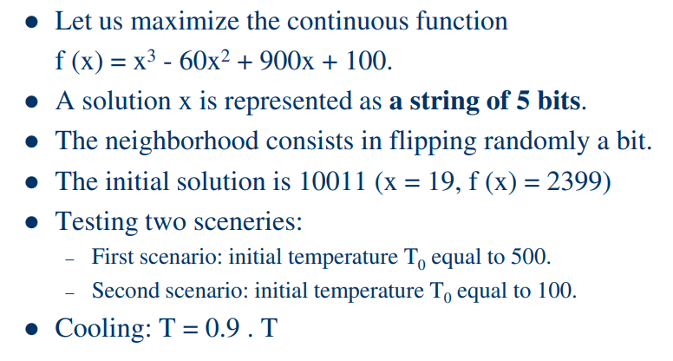
Simulated annealing example

Slide 95
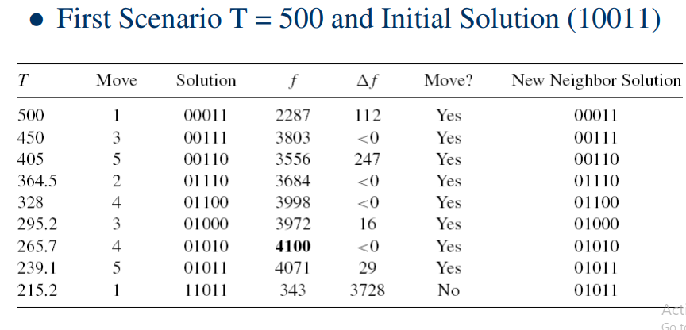
Simulated annealing example

Slide 96
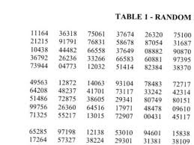
Simulated annealing example
 |  |  | 1. The objective function to minimize is a simple function of two variables:
 |  |  | min f(x) = (4 - 2.1*x1^2 + x1^4/3)*x1^2 + x1*x2 + (-4 + 4*x2^2)*x2^2;
 |  |  | x1, x2 >=0, x1,x2 <=20 |  |  |  | 5bits |  |  |  | Tmin = 50
k=1 |  | Binary x1 | Decimal x1 | Binary x2 | Decimal x2 | f(x) | Binary x1' | Decimal x1' | Binary x2' | Decimal x2' | f(x') | Delta E = f(x')-f(x) | Delta E<0? Accept | e(-DeltaE/T) | r | e(-DeltaE/T) < r? = Accept
T=300 |  | 10 | 2 | 1001 | 9 | 25941.73 | 0 | 0 | 1000 | 8 | 16128 | -9813.733333 | Yes |  |  | Accept
T=T/2=150 |  | 0 | 0 | 1000 | 8 | 16128 | 1 | 1 | 1100 | 12 | 82382.23 | 66254.23333 | No | 1.494E-192 | 0.6 | Accept
T=75 |  | 1 | 1 | 1100 | 12 | 82382.23 | 0 | 0 | 1110 | 14 | 152880 | 70497.76667 | No | 0 | 0.7 | Accept
T=37.5
 |  |  |  |  |  |  |  |  |  |  | 16128
 |  |  |  |  |  |  | 6
 |  | 2 | 5 | 1 | 1 | 3 | 2 | 1 | 2

Slide 97
Unit 2 List of Topics
Searching techniques – Uninformed search – General search Algorithm
Uninformed search Methods – Breadth First Search
Uninformed search Methods – Depth First Search
Uninformed search Methods – Depth limited Search
Uniformed search Methods- Iterative Deepening search
Bi-directional search
Informed search- Generate and test, Best First search
Informed search-A* Algorithm
AO* search
Local search Algorithms-Hill Climbing, Simulated Annealing
Local Beam Search
Genetic Algorithms
Adversarial search Methods-Game playing-Important concepts
Game playing and knowledge structure.
Game as a search problem-Minimax Approach
Minimax Algorithm
Alpha beta pruning
Game theory problems

Slide 98
Local Beam Search
Keep track of k states rather than just one, as in hill climbing
In comparison to beam search we saw earlier, this algorithm is state-based rather than node-based.

Slide 99
Local Beam Search
Begins with k randomly generated states
At each step, all successors of all k states are generated
If any one is a goal, alg halts
Otherwise, selects best k successors from the complete list, and repeats

Slide 100
Local Beam Search
Successors can become concentrated in a small part of state space
Stochastic beam search: choose k successors, with probability of choosing a given successor increasing with value
Like natural selection: successors (offspring) of a state (organism) populate the next generation according to its value (fitness)

Slide 101
Unit 2 List of Topics
Searching techniques – Uninformed search – General search Algorithm
Uninformed search Methods – Breadth First Search
Uninformed search Methods – Depth First Search
Uninformed search Methods – Depth limited Search
Uniformed search Methods- Iterative Deepening search
Bi-directional search
Informed search- Generate and test, Best First search
Informed search-A* Algorithm
AO* search
Local search Algorithms-Hill Climbing, Simulated Annealing
Local Beam Search
Genetic Algorithms
Adversarial search Methods-Game playing-Important concepts
Game playing and knowledge structure.
Game as a search problem-Minimax Approach
Minimax Algorithm
Alpha beta pruning
Game theory problems

Slide 102
Genetic Algorithms
Genetic Algorithms(GAs) are adaptive heuristic search algorithms that belong to the larger part of evolutionary algorithms. Genetic algorithms are based on the ideas of natural selection and genetics.
They are commonly used to generate high-quality solutions for optimization problems and search problems.
n simple words, they simulate “survival of the fittest” among individual of consecutive generation for solving a problem. Each generation consist of a population of individuals and each individual represents a point in search space and possible solution. Each individual is represented as a string of character/integer/float/bits. This string is analogous to the Chromosome.

Slide 103
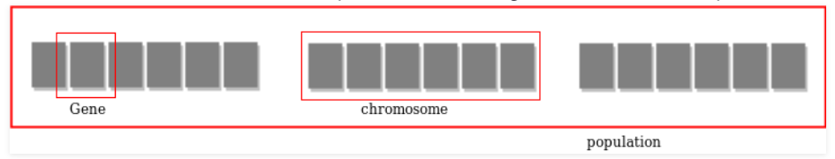
Genetic Algorithms
Search Space
The population of individuals are maintained within search space. Each individual represent a solution in search space for given problem. Each individual is coded as a finite length vector (analogous to chromosome) of components. These variable components are analogous to Genes. Thus a chromosome (individual) is composed of several genes (variable components).
A Fitness Score is given to each individual which shows the ability of an individual to “compete”. The individual having optimal fitness score (or near optimal) are sought.

Slide 104
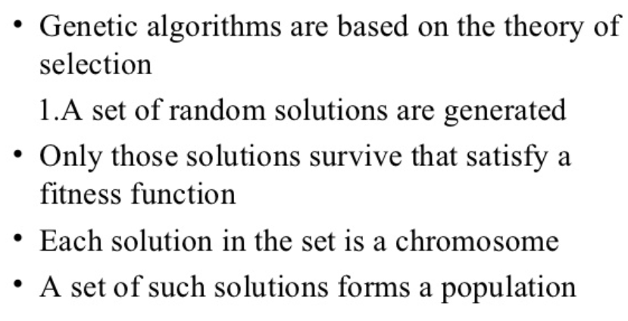
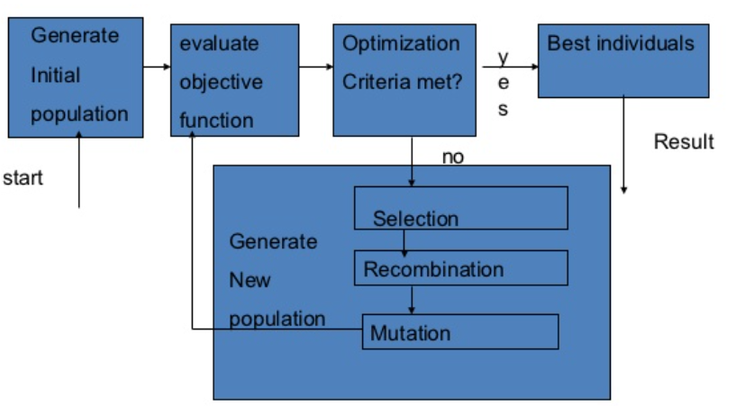
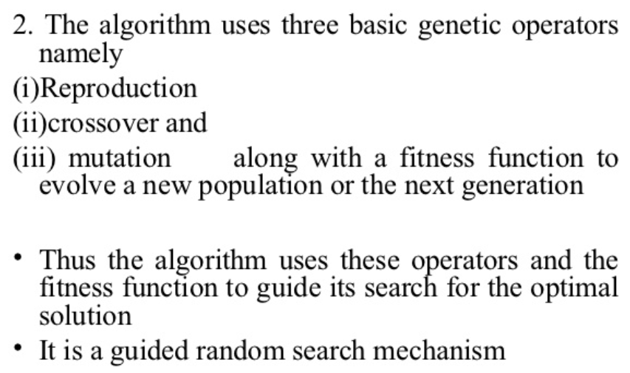
Genetic Algorithms

Slide 105
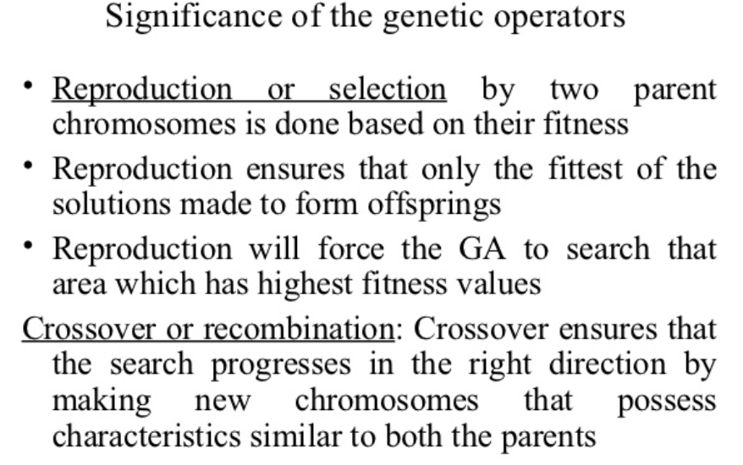
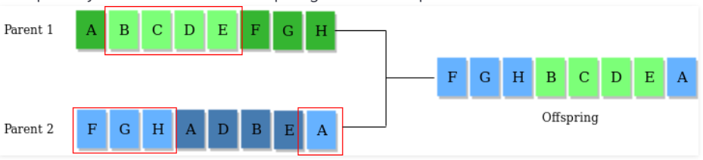


Genetic Algorithms
Cross Over
Mutation

Slide 106
GA can be summarized as:
1) Randomly initialize populations p
2) Determine fitness of population
3) Until convergence repeat:
a) Select parents from population
b) Crossover and generate new population
c) Perform mutation on new population
d) Calculate fitness for new population

Slide 107

Random Number Table for Solving
GA Problem

Slide 108


GA Calculation
Initial Pop | Decimal | Fitness | Pi | Ei | Actual Count | New Population | Crossover and Mutation

Slide 109
GA Example
Initial Pop | Decimal | F(Z) | Pi = F(z)/Sum F(z) | Ei = F(z)/ Avg(F(z)) | Actual Count | NEW POP | Crossover | Mutation | Offsprings | Decimal
00010 | 2 | 4 | 0.004 | 0.016 | 0 | 1|1010 | 11110 |  | 11110 | 30
01001 | 9 | 81 | 0.084 | 0.338 | 0 | 11010 | - | 11110 | 11110 | 30
11010 | 26 | 676 | 0.706 | 2.825 | 3 | 11010 |  |  | 11010 | 26
01110 | 14 | 196 | 0.206 | 0.81 | 1 | 0|1110 | 01010 |  | 01010 | 10
 | Sum F(z) | 937
 | Avg F(z) | 239.25
F(z) = x^2, 0<=x<=30;
Pc= 0.6, i.e. 0.6*4 = 2.4; i.e. 2 strings
Pm=0.2 , i.e. 0.2*4= 0.8, i.e.1 string

Slide 110
Unit 2 List of Topics
Searching techniques – Uninformed search – General search Algorithm
Uninformed search Methods – Breadth First Search
Uninformed search Methods – Depth First Search
Uninformed search Methods – Depth limited Search
Uniformed search Methods- Iterative Deepening search
Bi-directional search
Informed search- Generate and test, Best First search
Informed search-A* Algorithm
AO* search
Local search Algorithms-Hill Climbing, Simulated Annealing
Local Beam Search
Genetic Algorithms
Adversarial search Methods-Game playing-Important concepts
Game playing and knowledge structure.
Game as a search problem-Minimax Approach
Minimax Algorithm
Alpha beta pruning
Game theory problems

Slide 111
Adversarial search Methods-Game playing-Important concepts
Adversarial search: Search based on Game theory- Agents- Competitive environment
According to game theory, a game is played between two players. To complete the game, one has to win the game and the other looses automatically.’
Such Conflicting goal- adversarial search
Game playing technique- Those games- Human Intelligence and Logic factor- Excluding other factors like Luck factor
Tic-Tac-Toe, Checkers, Chess – Only mind works, no luck works

Slide 112

Adversarial search Methods-Game playing-Important concepts
Techniques required to get the best optimal solution (Choose Algorithms for best optimal solution within limited time)
Pruning: A technique which allows ignoring the unwanted portions of a search tree which make no difference in its final result.
Heuristic Evaluation Function: It allows to approximate the cost value at each level of the search tree, before reaching the goal node.

Slide 113
Unit 2 List of Topics
Searching techniques – Uninformed search – General search Algorithm
Uninformed search Methods – Breadth First Search
Uninformed search Methods – Depth First Search
Uninformed search Methods – Depth limited Search
Uniformed search Methods- Iterative Deepening search
Bi-directional search
Informed search- Generate and test, Best First search
Informed search-A* Algorithm
AO* search
Local search Algorithms-Hill Climbing, Simulated Annealing
Local Beam Search
Genetic Algorithms
Adversarial search Methods-Game playing-Important concepts
Game playing and knowledge structure.
Game as a search problem-Minimax Approach
Minimax Algorithm
Alpha beta pruning
Game theory problems

Slide 114

Game playing and knowledge structure- Elements of Game Playing search
To play a game, we use a game tree to know all the possible choices and to pick the best one out. There are following elements of a game-playing:
S₀: It is the initial state from where a game begins.
PLAYER (s): It defines which player is having the current turn to make a move in the state.
ACTIONS (s): It defines the set of legal moves to be used in a state.
RESULT (s, a): It is a transition model which defines the result of a move.
TERMINAL-TEST (s): It defines that the game has ended and returns true.
UTILITY (s,p): It defines the final value with which the game has ended. This function is also known as Objective function or Payoff function. The price which the winner will get i.e.
(-1): If the PLAYER loses.
(+1): If the PLAYER wins.
(0): If there is a draw between the PLAYERS.
For example, in chess, tic-tac-toe, we have two or three possible outcomes. Either to win, to lose, or to draw the match with values +1,-1 or 0.
Game Tree for Tic-Tac-Toe
Node: Game states, Edges: Moves taken by players

Slide 115
Game playing and knowledge structure- Elements of Game Playing search
INITIAL STATE (S₀): The top node in the game-tree represents the initial state in the tree and shows all the possible choice to pick out one.
PLAYER (s): There are two players, MAX and MIN. MAX begins the game by picking one best move and place X in the empty square box.
ACTIONS (s): Both the players can make moves in the empty boxes chance by chance.
RESULT (s, a): The moves made by MIN and MAX will decide the outcome of the game.
TERMINAL-TEST(s): When all the empty boxes will be filled, it will be the terminating state of the game.
UTILITY: At the end, we will get to know who wins: MAX or MIN, and accordingly, the price will be given to them.

Slide 116
Unit 2 List of Topics
Searching techniques – Uninformed search – General search Algorithm
Uninformed search Methods – Breadth First Search
Uninformed search Methods – Depth First Search
Uninformed search Methods – Depth limited Search
Uniformed search Methods- Iterative Deepening search
Bi-directional search
Informed search- Generate and test, Best First search
Informed search-A* Algorithm
AO* search
Local search Algorithms-Hill Climbing, Simulated Annealing
Local Beam Search
Genetic Algorithms
Adversarial search Methods-Game playing-Important concepts
Game playing and knowledge structure.
Game as a search problem-Minimax Approach
Minimax Algorithm
Alpha beta pruning
Game theory problems

Slide 117
Game as a search problem
Types of algorithms in Adversarial search
In a normal search, we follow a sequence of actions to reach the goal or to finish the game optimally. But in an adversarial search, the result depends on the players which will decide the result of the game. It is also obvious that the solution for the goal state will be an optimal solution because the player will try to win the game with the shortest path and under limited time.
Minmax Algorithm
Alpha-beta Pruning

Slide 118
Game Playing vs. Search
Game vs. search problem
"Unpredictable" opponent → specifying a move for every possible opponent reply
Time limits → unlikely to find goal, must approximate

Slide 119
Game Playing
Formal definition of a game:
Initial state
Successor function: returns list of (move, state) pairs
Terminal test: determines when game over
Terminal states: states where game ends
Utility function (objective function or payoff function): gives numeric value for terminal states
We will consider games with 2 players (Max and Min);
Max moves first.

Slide 120

Game Tree Example: Tic-Tac-Toe
Tree from
Max’s
perspective
Notes:
Crosses and noughts

Slide 121
Minimax Algorithm
Minimax algorithm
Perfect play for deterministic, 2-player game
Max tries to maximize its score
Min tries to minimize Max’s score (Min)
Goal: move to position of highest minimax value
→ Identify best achievable payoff against best play

Slide 122

Minimax Algorithm
Payoff for Max

Slide 123
Minimax Rule
Goal of game tree search: to determine one move for Max player that maximizes the guaranteed payoff for a given game tree for MAX
Regardless of the moves the MIN will take
The value of each node (Max and MIN) is determined by (back up from) the values of its children
MAX plays the worst case scenario:
Always assume MIN to take moves to maximize his pay-off (i.e., to minimize the pay-off of MAX)
For a MAX node, the backed up value is the maximum of the values associated with its children
For a MIN node, the backed up value is the minimum of the values associated with its children

Slide 124
Minimax procedure
Create start node as a MAX node with current board configuration
Expand nodes down to some depth (i.e., ply) of lookahead in the game.
Apply the evaluation function at each of the leaf nodes
Obtain the “back up" values for each of the non-leaf nodes from its children by Minimax rule until a value is computed for the root node.
Pick the operator associated with the child node whose backed up value determined the value at the root as the move for MAX

Slide 125
Minimax Search
2
2
1
2
1
2
7
1
8
2
7
1
8
2
7
1
8
This is the move
selected by minimax
2
Static evaluator
value
2
1
MAX
MIN
2
7
1
8

Slide 126
Minimax Algorithm (cont’d)
3
9
0
7
2
6
Payoff for Max

Slide 127
Minimax Algorithm (cont’d)
3
0
2
3
9
0
7
2
6
Payoff for Max

Slide 128
Minimax Algorithm (cont’d)
3
3
0
2
3
9
0
7
2
6
Payoff for Max

Slide 129
Minimax Algorithm (cont’d)
Properties of minimax algorithm:
Complete? Yes (if tree is finite) Optimal? Yes (against an optimal opponent) Time complexity? O(b^{m})
Space complexity? O(bm) (depth-first exploration, if it generates all successors at once)
m – maximum depth of tree; b branching factor
m – maximum depth of the tree; b – legal moves;

Slide 130
Minimax Algorithm
Limitations
Not always feasible to traverse entire tree
Time limitations
Key Improvement
Use evaluation function instead of utility
Evaluation function provides estimate of utility at given position
Notes:
Similar to heuristic function

Slide 131
Unit 2 List of Topics
Searching techniques – Uninformed search – General search Algorithm
Uninformed search Methods – Breadth First Search
Uninformed search Methods – Depth First Search
Uninformed search Methods – Depth limited Search
Uniformed search Methods- Iterative Deepening search
Bi-directional search
Informed search- Generate and test, Best First search
Informed search-A* Algorithm
AO* search
Local search Algorithms-Hill Climbing, Simulated Annealing
Local Beam Search
Genetic Algorithms
Adversarial search Methods-Game playing-Important concepts
Game playing and knowledge structure.
Game as a search problem-Minimax Approach
Minimax Algorithm
Alpha beta pruning
Game theory problems

Slide 132
α-β Pruning
Can we improve search by reducing the size of the game tree to be examined?
→ Yes!!! Using alpha-beta pruning
Principle
If a move is determined worse than another move already examined, then there is no need for further examination of the node.

Slide 133

α-β Pruning Example

Slide 134

α-β Pruning Example (cont’d)

Slide 135

α-β Pruning Example (cont’d)

Slide 136

α-β Pruning Example (cont’d)

Slide 137

α-β Pruning Example (cont’d)

Slide 138
Alpha-Beta Pruning (αβ prune)
Rules of Thumb
α is the best ( highest) found so far along the path for Max
β is the best (lowest) found so far along the path for Min
Search below a MIN node may be alpha-pruned if the its β ≤ α of some MAX ancestor
Search below a MAX node may be beta-pruned if the its α≥ β of some MIN ancestor.

Slide 139
Alpha-Beta Pruning Example
Search below a MIN node may be alpha-pruned if the beta value is <= to the alpha value of some MAX ancestor.
2. Search below a MAX node may be beta-pruned if the alpha value is >= to the beta value of some MIN ancestor.

Slide 140
Alpha-Beta Pruning Example
Search below a MIN node may be alpha-pruned if the beta value is <= to the alpha value of some MAX ancestor.
2. Search below a MAX node may be beta-pruned if the alpha value is >= to the beta value of some MIN ancestor.
3
3
3

Slide 141
Alpha-Beta Pruning Example
Search below a MIN node may be alpha-pruned if the beta value is <= to the alpha value of some MAX ancestor.
2. Search below a MAX node may be beta-pruned if the alpha value is >= to the beta value of some MIN ancestor.
3
3
3
5
β

Slide 142
Alpha-Beta Pruning Example
Search below a MIN node may be alpha-pruned if the beta value is <= to the alpha value of some MAX ancestor.
2. Search below a MAX node may be beta-pruned if the alpha value is >= to the beta value of some MIN ancestor.
3
3
0
α
3
5
0
β

Slide 143
Alpha-Beta Pruning Example
Search below a MIN node may be alpha-pruned if the beta value is <= to the alpha value of some MAX ancestor.
2. Search below a MAX node may be beta-pruned if the alpha value is >= to the beta value of some MIN ancestor.
3
3
0
2
α
α
3
5
0
2
β

Slide 144

The α-β algorithm

Slide 145

The α-β algorithm

Slide 146

Another Example
Search below a MIN node may be alpha-pruned if the beta value is <= to the alpha value of some MAX ancestor.
2. Search below a MAX node may be beta-pruned if the alpha value is >= to the beta value of some MIN ancestor.

Slide 147
Example
Search below a MIN node may be alpha-pruned if the beta value is <= to the alpha value of some MAX ancestor.
2. Search below a MAX node may be beta-pruned if the alpha value is >= to the beta value of some MIN ancestor.
5
5
3
5
3
5
6
3
7
α
5
6
3
5
0
6
1
3
2
4
7
β

Slide 148

Why is it called α-β?
α is the value of the best (i.e., highest-value) choice found so far at any choice point along the path for max
If v is worse than α, max will avoid it
→ prune that branch
Define β similarly for min

Slide 149
Properties of α-β Prune
Pruning does not affect final result
Good move ordering improves effectiveness of pruning b(e.g., chess, try captures first, then threats, froward moves, then backward moves…)
With "perfect ordering," time complexity = O(b^{m/2})
→ doubles depth of search that alpha-beta pruning can explore
Example of the value of reasoning about which
computations are relevant (a form of metareasoning)

Slide 150
Unit 2 List of Topics
Searching techniques – Uninformed search – General search Algorithm
Uninformed search Methods – Breadth First Search
Uninformed search Methods – Depth First Search
Uninformed search Methods – Depth limited Search
Uniformed search Methods- Iterative Deepening search
Bi-directional search
Informed search- Generate and test, Best First search
Informed search-A* Algorithm
AO* search
Local search Algorithms-Hill Climbing, Simulated Annealing
Local Beam Search
Genetic Algorithms
Adversarial search Methods-Game playing-Important concepts
Game playing and knowledge structure.
Game as a search problem-Minimax Approach
Minimax Algorithm
Alpha beta pruning
Game theory problems

Slide 151
What is Game Theory?
It deals with Bargaining.
The whole process can be expressed Mathematically
Based on Behavior Theory, has a more casual approach towards study of Human Behavior.
It also considers how people Interact in Groups.

Slide 152
Game Theory Definition
Theory of rational behavior for interactive decision problems.
In a game, several agents strive to maximize their (expected) utility index by choosing particular courses of action, and each agent's final utility payoffs depend on the profile of courses of action chosen by all agents.
The interactive situation, specified by the set of participants, the possible courses of action of each agent, and the set of all possible utility payoffs, is called a game;
the agents 'playing' a game are called the players.

Slide 153
Definitions
Definition: Zero-Sum Game – A game in which the payoffs for the players always adds up to zero is called a zero-sum game.
Definition: Maximin strategy – If we determine the least possible payoff for each strategy, and choose the strategy for which this minimum payoff is largest, we have the maximin strategy.

Slide 154
A Further Definition
Definition: Constant-sum and nonconstant-sum game – If the payoffs to all players add up to the same constant, regardless which strategies they choose, then we have a constant-sum game. The constant may be zero or any other number, so zero-sum games are a class of constant-sum games. If the payoff does not add up to a constant, but varies depending on which strategies are chosen, then we have a non-constant sum game.

Slide 155
Game theory: assumptions
(1) Each decision maker has available to him two or more well-specified choices or sequences of choices.
(2) Every possible combination of plays available to the players leads to a well-defined end-state (win, loss, or draw) that terminates the game.
(3) A specified payoff for each player is associated with each end-state.

Slide 156
Game theory: assumptions (Cont)
(4) Each decision maker has perfect knowledge of the game and of his opposition.
(5) All decision makers are rational; that is, each player, given two alternatives, will select the one that yields him the greater payoff.

Slide 157
Rules, Strategies, Payoffs, and Equilibrium
A game is a contest involving two or more decision makers, each of whom wants to win
Game theory is the study of how optimal strategies are formulated in conflict
A player's payoff is the amount that the player wins or loses in a particular situation in a game.
A players has a dominant strategy if that player's best strategy does not depend on what other players do.
A two-person game involves two parties (X and Y)
A zero-sum game means that the sum of losses for one player must equal the sum of gains for the other. Thus, the overall sum is zero
Notes:
4

Slide 158
Rules, Strategies, Payoffs, and Equilibrium
Economic situations are treated as games.
The rules of the game state who can do what, and when they can do it.
A player's strategy is a plan for actions in each possible situation in the game.
Strategies taken by others can dramatically affect the outcome of our decisions
In the auto industry, the strategies of competitors to introduce certain models with particular features can impact the profitability of other carmakers
Notes:
3

Slide 159

Payoff Matrix - Store X
Two competitors are planning radio and newspaper advertisements to increase their business. This is the payoff matrix for store X. A negative number means store Y has a positive payoff

Slide 160

Game Outcomes

Slide 161
Minimax Criterion
Look to the “cake cutting problem” to explain
Cutter – maximize the minimum the Chooser will leave him
Chooser – minimize the maximum the Cutter will get
Chooser → Cutter | Choose bigger piece | Choose smaller piece
Cut cake as evenly as possible | Half the cake minus a crumb | Half the cake plus a crumb
Make one piece bigger than the other | Small piece | Big piece
Notes:
4

Slide 162
Minimax Criterion
The game favors competitor X, since all values are positive except one.
This means X would get a positive payoff in 3 of the 4 strategies and Y has a positive payoff in only 1 strategy
Since Y must play the game (do something about the competition), he will play to minimize total losses using the minimax criterion.
Notes:
4

Slide 163
Minimax Criterion
For a two-person, zero-sum game, each person chooses the strategy that minimizes the maximum loss or maximize one’s minimum gains
Player Y (columns)is looking at a maximum loss of 3 under strategy Y1 and loss of 5 under Y2
Y should choose Y1 which results in a maximum loss of 3 (minimum of 3 and 5) – minimum of the maximums (upper value of the game)
The minimum payoffs for X (rows) are +3 (strategy X1 ) and -5 (strategy X2)
X should choose strategy X1 – the maximum of the minumums (lower value of the game)
Notes:
4

Slide 164

Minimax Criterion
If the upper and lower values are the same, the number is called the value of the game and an equilibrium or saddle point condition exists
The value of a game is the average or expected game outcome if the game is played an infinite number of times
A saddle point indicates that each player has a pure strategy i.e., the strategy is followed no matter what the opponent does
Notes:
4

Slide 165

Saddle Point
Von Neumann likened the solution point to the point in the middle of a saddle shaped mountain pass
It is, at the same time, the maximum elevation reached by a traveler going through the pass to get to the other side and the minimum elevation encountered by a mountain goat traveling the crest of the range

Slide 166
Pure Strategy - Minimax Criterion
 |  | Player Y’s Strategies |  | Minimum Row Number
 |  | Y1 | Y2
Player X’s strategies | X1 | 10 | 6 | 6
 | X2 | -12 | 2 | -12
Maximum Column Number |  | 10 | 6

Slide 167
Mixed Strategy Game
When there is no saddle point, players will play each strategy for a certain percentage of the time
The most common way to solve a mixed strategy is to use the expected gain or loss approach
A player plays each strategy a particular percentage of the time so that the expected value of the game does not depend upon what the opponent does
 | Y1 P | Y2 1-P | Expected Gain
X1 Q | 4 | 2 | 4P+2(1-P)
X2 1-Q | 1 | 10 | 1P+10(1-p)
 | 4Q+1(1-Q) | 2Q+10(1-q)
Notes:
4

Slide 168
Mixed Strategy Game
: Solving for P & Q
4P+2(1-P) = 1P+10(1-P)
or: P = 8/11 and 1-p = 3/11
Expected payoff:
1P+10(1-P)
=1(8/11)+10(3/11)
EP_{X}= 3.46
4Q+1(1-Q)=2Q+10(1-q)
or: Q=9/11 and 1-Q = 2/11
Expected payoff:
EP_{Y}=3.46

Slide 169

Mixed Strategy Game : Example
Using the solution procedure for a mixed strategy game, solve the following game

Slide 170

Example
Mixed Strategy Game
This game can be solved by setting up the mixed strategy table and developing the appropriate equations:

Slide 171

Mixed Strategy Game: Example

Slide 172
Two-Person Zero-Sum and Constant-Sum Games
Two-person zero-sum and constant-sum games are played according to the following basic assumption:
Each player chooses a strategy that enables him/her to do the best he/she can, given that his/her opponent knows the strategy he/she is following.
A two-person zero-sum game has a saddle point if and only if
Max (row minimum) = min (column maximum)
all all
rows columns
(1)

Slide 173
Two-Person Zero-Sum and Constant-Sum Games (Cont)
If a two-person zero-sum or constant-sum game has a saddle point, the row player should choose any strategy (row) attaining the maximum on the right side of (1). The column player should choose any strategy (column) attaining the minimum on the right side of (1).
In general, we may use the following method to find the optimal strategies and value of two-person zero-sum or constant-sum game:
Step 1 Check for a saddle point. If the game has none, go on to step 2.

Slide 174
Two-Person Zero-Sum and Constant-Sum Games (Cont)
Step 2 Eliminate any of the row player’s dominated strategies. Looking at the reduced matrix (dominated rows crossed out), eliminate any of the column player’s dominated strategies and then those of the row player. Continue until no more dominated strategies can be found. Then proceed to step 3.
Step 3 If the game matrix is now 2 x 2, solve the game graphically. Otherwise, solve by using a linear programming method.

Slide 175
Zero Sum Games
Game theory assumes that the decision maker and the opponent are rational, and that they subscribe to the maximin criterion as the decision rule for selecting their strategy
This is often reasonable if when the other player is an opponent out to maximize his/her own gains, e.g. competitor for the same customers.
Consider:
Player 1 with three strategies S1, S2, and S3 and Player 2 with four strategies OP1, OP2, OP3, and OP4.

Slide 176
Zero Sum Games (Cont)
The value 4 achieved by both players is called the value of the game
The intersection of S2 and OP2 is called a saddle point. A game with a saddle point is also called a game with an equilibrium solution.
At the saddle point, neither player can improve their payoff by switching strategies

Slide 177

Zero Sum Games- To do problem!
Let’s take the following example: Two TV channels (1 and 2) are competing for an audience of 100 viewers. The rule of the game is to simultaneously announce the type of show the channels will broadcast. Given the payoff matrix below, what type of show should channel 1 air?

Slide 178
Two-person zero-sum game – Dominance property
dominance method Steps (Rule)
Step-1: | 1. If all the elements of Column-i are greater than or equal to the corresponding elements of any other Column-j, then the Column-i is dominated by the Column-j and it is removed from the matrix. eg. If Column-2 ≥ Column-4, then remove Column-2
Step-2: | 1. If all the elements of a Row-i are less than or equal to the corresponding elements of any other Row-j, then the Row-i is dominated by the Row-j and it is removed from the matrix. eg. If Row-3 ≤ Row-4, then remove Row-3
Step-3: | Again repeat Step-1 & Step-2, if any Row or Column is dominated, otherwise stop the procedure.

Slide 179
Two-person zero-sum game – Dominance property- To do problem!
_{Player A}\^{Player B} | B1 | B2 | B3 | B4
A1 | 3 | 5 | 4 | 2
A2 | 5 | 6 | 2 | 4
A3 | 2 | 1 | 4 | 0
A4 | 3 | 3 | 5 | 2
Solution |  | Player B
 |  |  | B3 | B4
Player A | A2 |  | 2 | 4
 | A4 |  | 5 | 2
 | B3 | B4
A2 | 2 | 4
A4 | 5 | 2

Slide 180
The Prisoner’s Dilemma
The prisoner’s dilemma is a universal concept. Theorists now realize that prisoner’s dilemmas occur in biology, psychology, sociology, economics, and law.
The prisoner’s dilemma is apt to turn up anywhere a conflict of interests exists -- and the conflict need not be among sentient beings.
Study of the prisoner’s dilemma has great power for explaining why animal and human societies are organized as they are. It is one of the great ideas of the twentieth century, simple enough for anyone to grasp and of fundamental importance (...).
The prisoner’s dilemma has become one of the premier philosophical and scientific issues of our time. It is tied to our very survival (W. Poundstone,1992, p. 9).

Slide 181
Prisoner’s Dilemma
Two members of a criminal gang are arrested and imprisoned.
They are placed under solitary confinement and have no chance of communicating with each other
The district attorney would like to charge them with a recent major crime but has insufficient evidence
He has sufficient evidence to convict each of them of a lesser charge
If he obtains a confession from one or both the criminals, he can convict either or both on the major charge.

Slide 182
Prisoner’s Dilemma
The district attorney offers each the chance to turn state’s evidence.
If only one prisoner turns state’s evidence and testifies against his partner he will go free while the other will receive a 3 year sentence.
Each prisoner knows the other has the same offer
The catch is that if both turn state’s evidence, they each receive a 2 year sentence
If both refuse, each will be imprisoned for 1 year on the lesser charge

Slide 183
A game is described by
The number of players
Their strategies and their turn
Their payoffs (profits, utilities etc) at the outcomes of the game

Slide 184
Payoff matrix Normal- or strategic form
Game Theory Definition
Player B
 | Left | Right
Top | 3, 0 | 0, -4
Bottom | 2, 4 | -1, 3
Player A

Slide 185
How to solve a situation like this?
Game Playing
The most simple case is where there is a optimal choice of strategy no matter what the other players do; dominant strategies.
Explanation: For Player A it is always better to choose Top, for Player B it is always better to choose left.
A dominant strategy is a strategy that is best no matter what the other player does.

Slide 186
Nash equilibrium
If Player A’s choice is optimal given Player B’s choice, and B’s choice is optimal given A’s choice, a pair of strategies is a Nash equilibrium.
When the other players’ choice is revealed neither player like to change her behavior.
If a set of strategies are best responses to each other, the strategy set is a Nash equilibrium.

Slide 187
Payoff matrix Normal- or strategic form
Player B
 | Left | Right
Top | 1, 1 | 2, 3*
Bottom | 2, 3* | 1, 2
Player A

Slide 188
Solution
Here you can find a Nash equilibrium; Top is the best response to Right and Right is the best response to Top. Hence, (Top, Right) is a Nash equilibrium.
But there are two problems with this solution concept.

Slide 189
Problems
A game can have several Nash equilibriums. In this case also (Bottom, Left).
There may not be a Nash equilibrium (in pure strategies).

Slide 190
Payoff matrix Normal- or strategic form
Player B
 | Left | Right
Top | 1, -1 | -1, 1
Bottom | -1, 1 | 1, -1
Player A

Slide 191
Nash equilibrium in mixed strategies
Here it is not possible to find strategies that are best responses to each other.
If players are allowed to randomize their strategies we can find s solution; a Nash equilibrium in mixed strategies.
An equilibrium in which each player chooses the optimal frequency with which to play her strategies given the frequency choices of the other agents.

Slide 192
The prisoner’s dilemma
Two persons have committed a crime, they are held in separate rooms. If they both confess they will serve two years in jail. If only one confess she will be free and the other will get the double time in jail. If both deny they will be hold for one year.

Slide 193
Prisoner’s dilemma Normal- or strategic form
Prisoner B
 | Confess | Deny
Confess | -2, -2 | 0, -4
Deny | -4, 0 | -1, -1*
Prisoner A
Solution
Confess is a dominant strategy for both. If both Deny they would be better off. This is the dilemma.

Slide 194
Nash Equilibrium – To do Problems!
 | HENRY
JANE |  | L | R
 | U | 8,7 | 4,6
 | D | 6,5 | 7,8
 | McD (1)
KFC (1) |  | L | R
 | U | 9,9* | 1,10
 | D | 10,1 | 2,2
 | COKE
PEPSI |  | L | R
 | U | 6,8* | 4,7
 | D | 7,6 | 3,7
 | B
A |  | L | R
 | U | 7,6* | 5,5
 | D | 4,5 | 6,4

Slide 195
GAME PLAYING & MECHANISM DESIGN
Mechanism Design is the design of games or
reverse engineering of games; could be called
Game Engineering
Involves inducing a game among the players
such that in some equilibrium of the game,
a desired social choice function is implemented

Slide 196



Example 1: Mechanism Design Fair Division of a Cake
GAME PLAYING & MECHANISM DESIGN
Mother
Social Planner
Mechanism Designer
Kid 1
Rational and
Intelligent
Kid 2
Rational and
Intelligent

Slide 197



Example 2: Mechanism Design Truth Elicitation through an Indirect Mechanism
GAME PLAYING & MECHANISM DESIGN
Tenali Rama
(Birbal)
Mechanism Designer
Baby
Mother 1
Rational and
Intelligent Player
Mother 2
Rational and
Intelligent Player

Slide 198
GAME PLAYING & MECHANISM DESIGN
One Seller, Multiple Buyers, Single Indivisible Item
Example: B1: 40, B2: 45, B3: 60, B4: 80
Winner: whoever bids the highest; in this case B4
Payment: Second Highest Bid: in this case, 60.
Vickrey showed that this mechanism is Dominant Strategy
Incentive Compatible (DSIC) ;Truth Revelation is good for
a player irrespective of what other players report
MECHANISM DESIGN: EXAMPLE 3 : VICKREY AUCTION

Slide 199


Four Basic Types of Auctions
GAME PLAYING & MECHANISM DESIGN
Dutch Auction
English Auction
1
1
0, 10, 20, 30,
40, 45, 50, 55,
58, 60, stop.
100, 90, 85, 75, 70, 65, 60, stop.
n
Seller
n
Buyers
Auctioneer or seller
Buyers
First Price Auction
Vickrey Auction
1
40
40
1
2
50
Winner = 4 Price = 60
2
45
Winner = 4 Price = 60
3
55
3
60
4
60
4
80
Buyers
Buyers

Slide 200
END
UNIT-2

